Slide 1
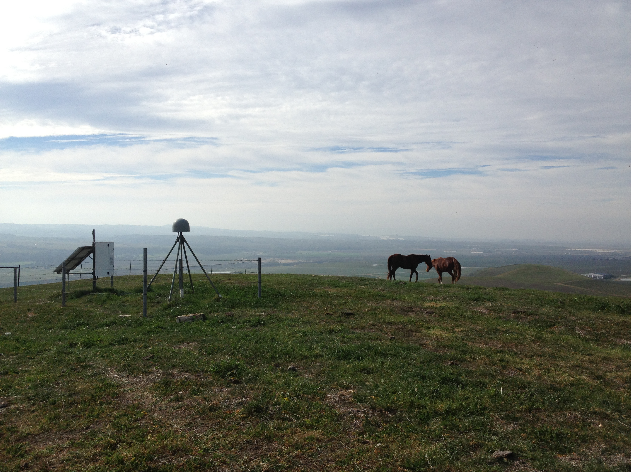

Disaster Mitigation Applications of
Terrestrial GNSS
Dr. Angelyn Moore
Jet Propulsion Laboratory, California Institute of Technology
15 November 2017
©2017 California Institute of Technology. Government sponsorship acknowledged.

Slide 2
Typical western U.S. ground GPS station as installed by geodetic community
Dual-freq GPS antenna (under radome)
GPS receiver and comm equipment
Deep drilled braced monument (legs grouted into bedrock 10 m deep)
Photo courtesy UNAVCO
Notes:
Z≥≥≥≥≥dhjuk,.

Slide 3
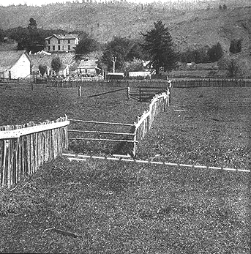
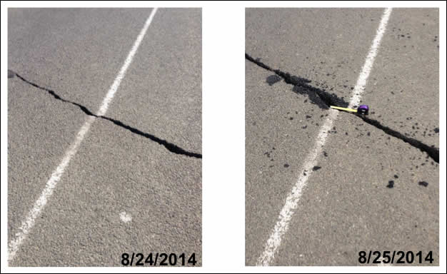
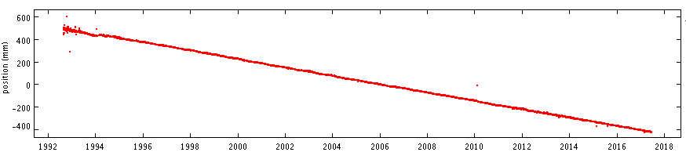
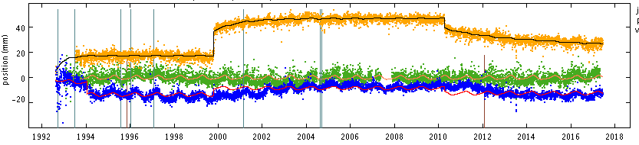
Ground GPS reveals motion between and during earthquakes
JPLM East Coordinate
Long-term slope:
tectonic plate velocity
Postseismic motion
Earthquake offset
Photo credit: USGS
1999 Hector Mine
2010 El Mayor-Cucapah
North Coordinate
(detrended)
PIN1
JPLM
VNDP
1994 Northridge earthquake
Notes:
The original geodetic motivation to install these stations was to measure mm-level motions on a ~daily basis. Over the long term, the linear slope of site motion determines the velocity of the tectonic plate. When detrended, these time series reveal the precise permanent offsets that occur in earthquakes. GPS and seismology are complementary – seismometers saturate or clip, and do not allow precise measurement of offsets.

Slide 4
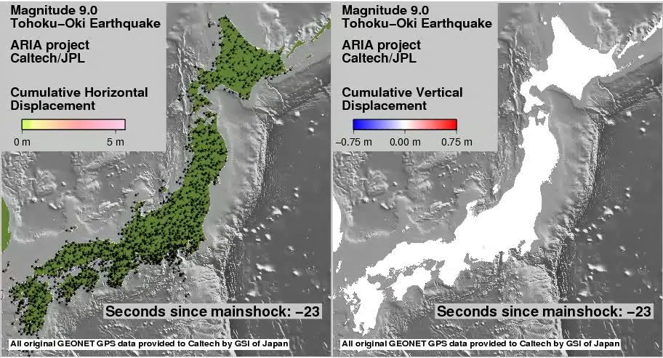
GPS can also measure the movement during an earthquake
Notes:
Ground GPS can also measure the wave motion during an earthquake in great detail. Japan invested heavily in ground GPS and had ~1200 stations at the time of the devastating Tohoku-Oki earthquake and tsunami. In this animation we are watching the position of each station measured once per second. On the right is the vertical motion, and you can see the up/down waves, as if a stone thrown in a pond, traveling through the south of Japan nearly 8 minutes later. These are actual measurements, not a model.

Slide 5
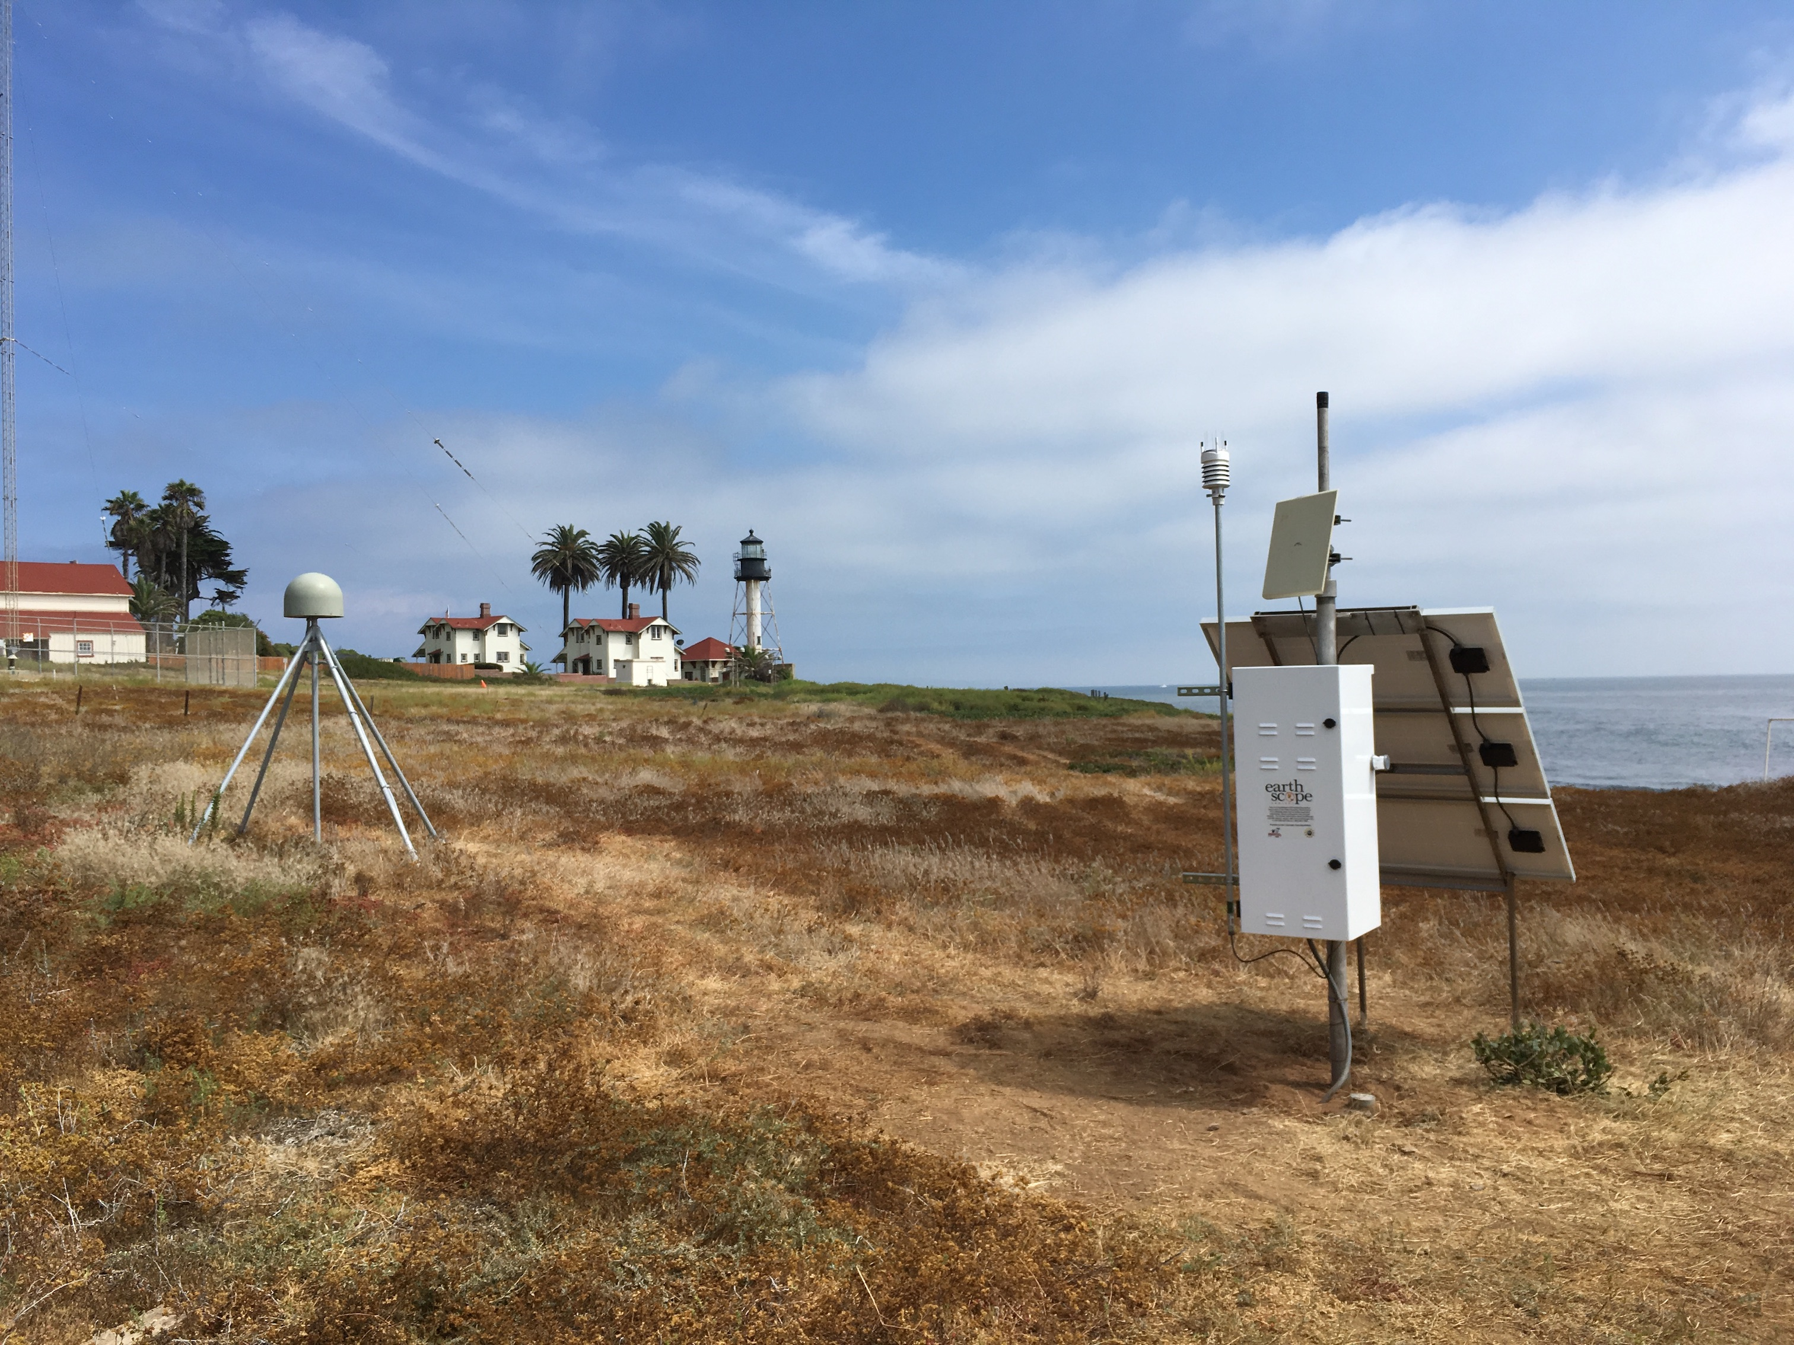
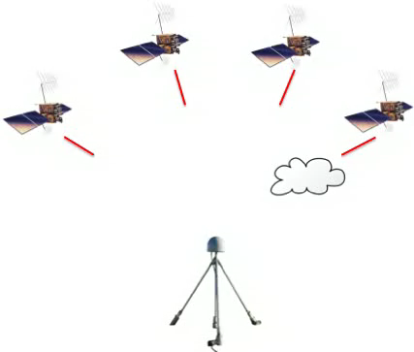
Ground GPS meteorology
Because GPS is a time-of-flight technique, when we estimate the station’s position, we automatically also estimate the amount of delay due to water vapor.
Given co-located surface pressure and temperature measurements, the delay can be converted into Precipitable Water (PW), a figure familiar to meteorologists.
GPS is uniquely able to precisely determine PW near-continuously
Photo courtesy UNAVCO
Notes:
GPS PW is used by operational forecasters for situational awareness, and is assimilated into the NOAA National Centers for Environmental (NCEP) weather models (except GFS)

Slide 6
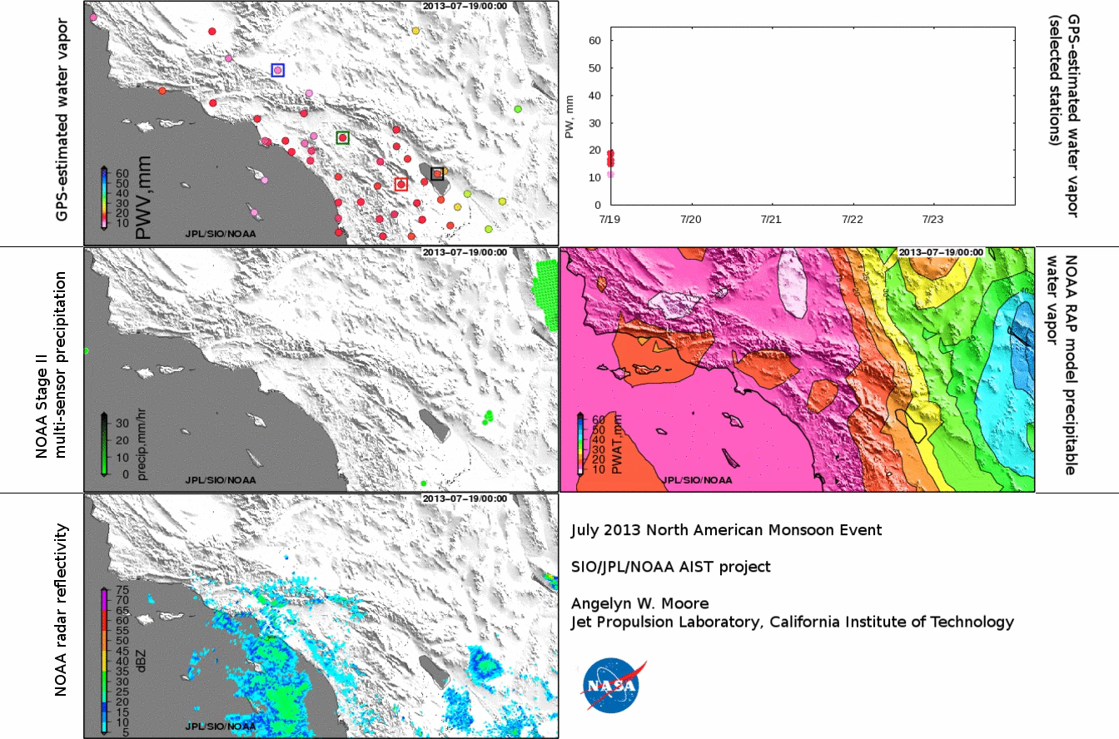
Ground GPS Meteorology
Uniquely able to precisely determine Precipitable Water Vapor near-continuously
Notes:
Here GPS PW (upper row) is compared with radar, weather model, and blended precipitation products in a 2013 North American Monsoon event. GPS PW is the only measurement that provides an accurate, near-continuous measurement of PW over land.

Slide 7
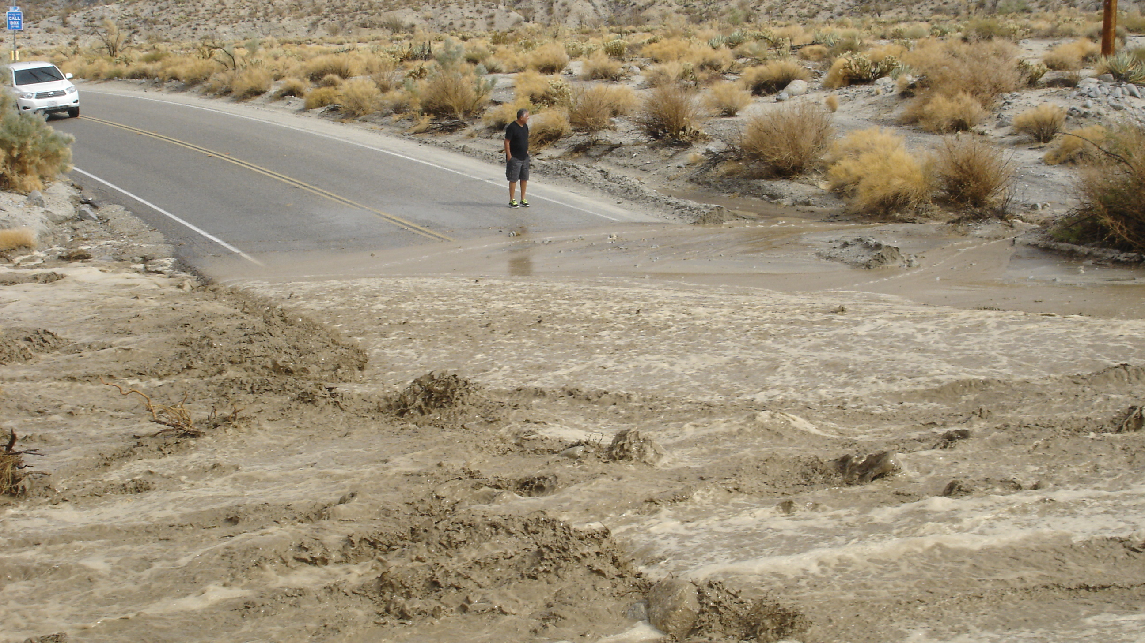
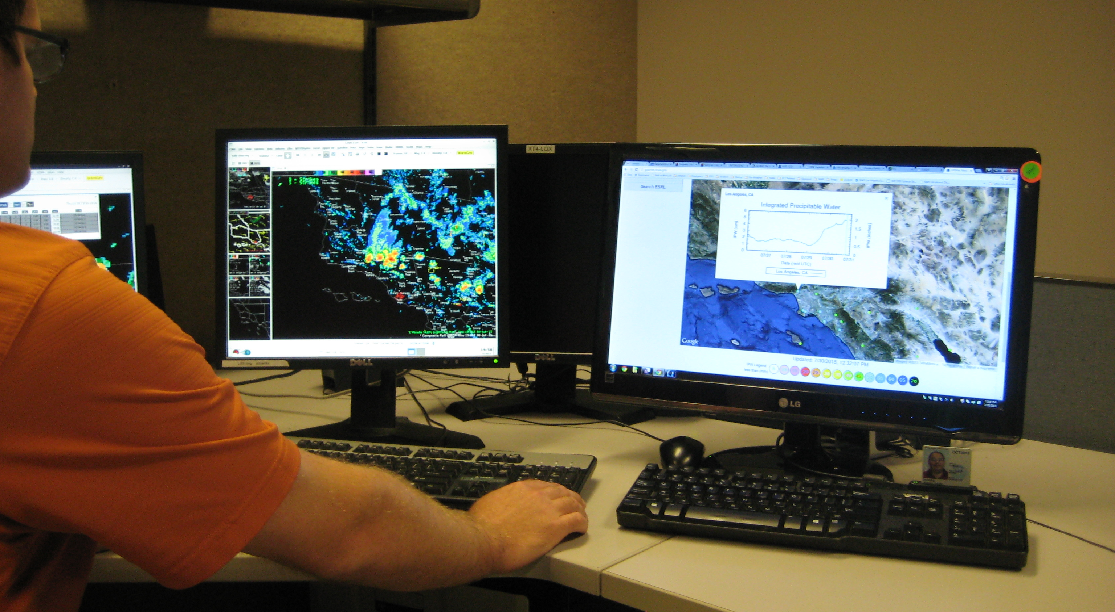
Ground GPS meteorology
Photo credit: A. Tardy, NWS
R. Munroe (NWS) consults GPS PW at the National Weather Service LA/Oxnard forecast during developing storms.
Photo courtesy J. Laber, NWS
Notes:
GPS PW is used by operational forecasters for situational awareness, and is assimilated into the NOAA National Centers for Environmental (NCEP) weather models (except GFS)

Slide 8
GPS Interferometric Reflectometry (GPS-IR) detects changes in
snow, soil moisture, and vegetation
We use the interference pattern created by the direct and reflected signal power to infer changes in the reflecting surface
Photo courtesy UNAVCO

Slide 9
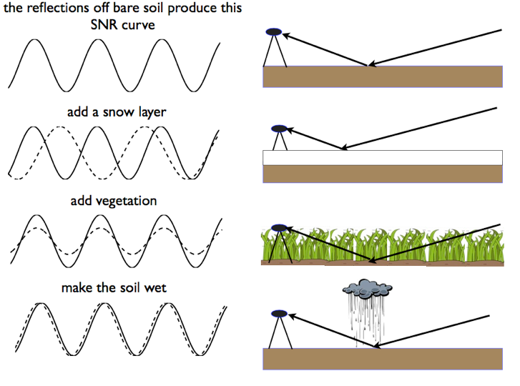
GPS-IR detects changes in snow, soil moisture, and vegetation
Illustration courtesy K. Larson
Notes:
Snow alters the frequency of the interfered signal; soil moisture alters the phase; and vegetation reduces the amplitude.

Slide 10
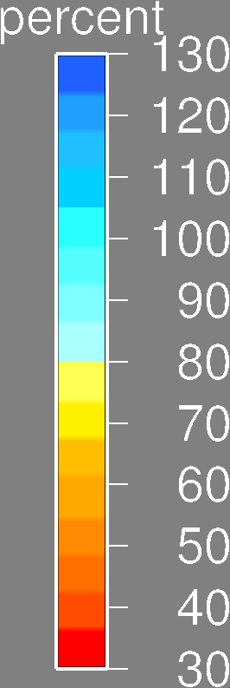
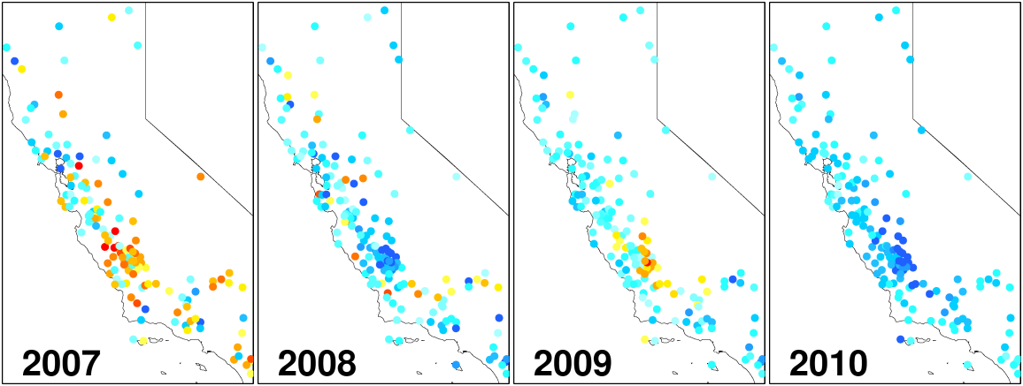
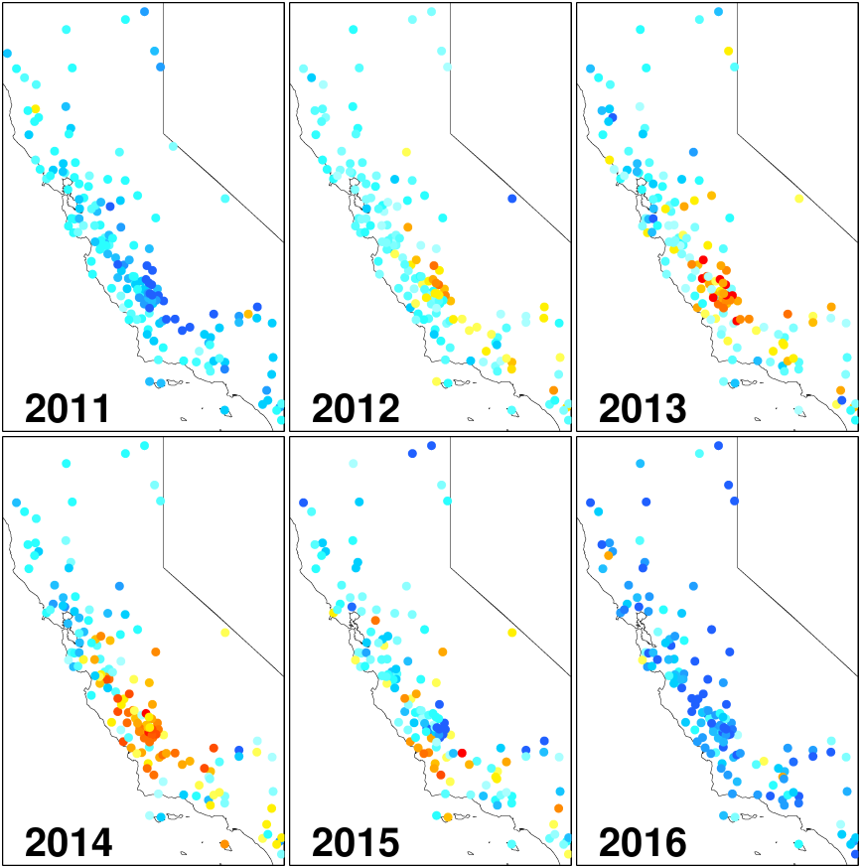
GPS-IR vegetation index reveals California droughts
(2007, 2012-2015)
Blue is dense vegetation (compared to a multi-year average); red is sparse
Peak annual GPS-IR vegetation water content (health), reported as percentage of the 2008-2012 average
After Larson 2016
Notes:
GPS-IR vegetation index reveals the California droughts of 2007 and 2012-2015. GPS-IR can be used as calibration/validation data for satellite missions (e.g. SMAP soil moisture).

Slide 11
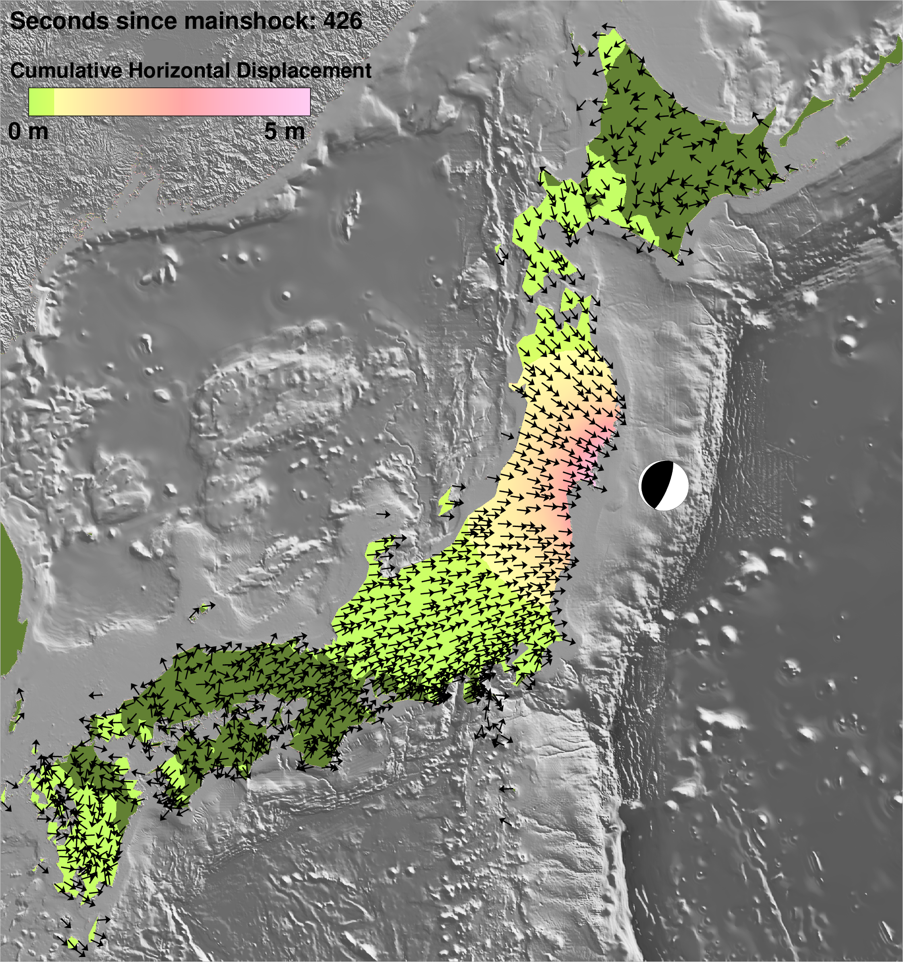
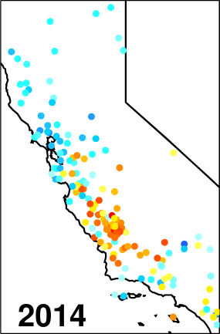
(Some) Disaster Mitigation Applications of Terrestrial GNSS
Tectonics
Meteorology
Meteorology
Hydrology

