Slide 1
Using CORS and OPUS for Positioning
Richard Snay
NOAA’s National Geodetic Survey
GIS-T
Charleston, West Virginia
April 14, 2010
Notes:
Present introductory remarks.

Slide 2

NOAA’s National Geodetic Survey
Everyone is able to know where they are and
where other things are anytime, anyplace!

Slide 3
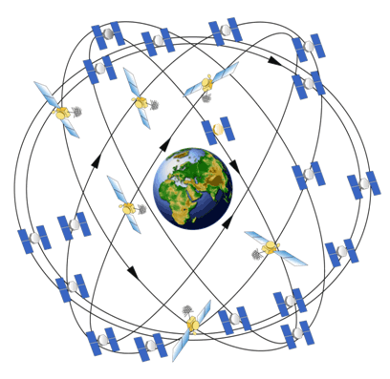
The Global Positioning System (GPS)
Unaugmented GPS enables positioning with
accuracies ranging from 1 to 10 meters.
Notes:
Currently, the unaugmented Global Positioning System (GPS) enables 3-dimensional positioning with accuracies ranging from 1 to 10 meters.

Slide 4
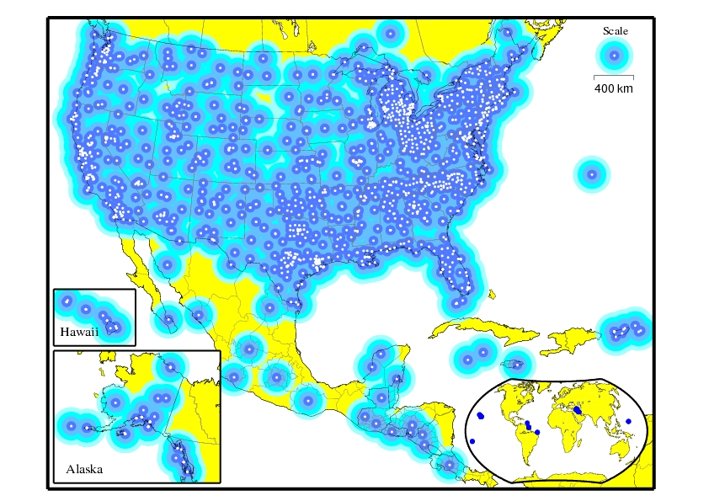
The CORS network enables differential GPS positioning with accuracies from 1 to 10 centimeters, or better.
Continuously Operating
Reference Stations (CORS)
Notes:
The U.S. Continuously Operating Reference Station (CORS) system constitutes a GPS augmentation that enables differential positioning with accuracies from 1 to 10 centimeters, or better, in the post-processing mode. The CORS system is comprised of over 1,300 GPS data-collection sites spanning the United States, its territories, and a few foreign countries.

Slide 5
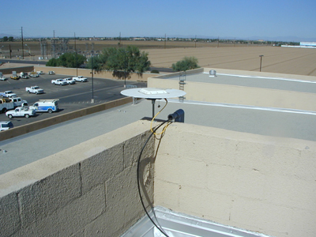
Sample CORS Sites
Notes:
The CORS system incorporates various types of GNSS equipment, deployed in numerous types of settings. This graphic shows only two types of settings. On the left, the GNSS antenna is mounted on the roof of a building. Rooftop settings afford relatively unobstructed satellite visibility. Rooftop antennas are also relatively safe from theft and vandalism. On the downside, the building may not be as stable as desired. The antenna on the right is mounted on an extremely stable structure, because it has been installed to monitor crustal deformation as part of EarthScope’s Plate Boundary Observatory (PBO). Each leg of this structure extends approximately 10 meters into the ground, and the various legs are welded to one another where they converge. Over 1,000 PBO sites will be established in western U. S. locations where earthquakes and/or volcanic activity are prevalent. UNAVCO operates these PBO sites with funding from the U.S. National Science Foundation and others. UNAVCO provides NOAA with access to data from PBO sites for use in CORS operations. PBO sites currently comprise about 15% of the CORS network.

Slide 6
CORS Information
CORS network contains over 1,400 stations as of April 2010.
Growing at rate of about 200 stations per year.
Each station collects GPS signals, and NOAA makes these data freely available to the public via the Internet for post-processing applications.
Over 200 organizations participate in the CORS program by sponsoring and operating one or more stations.
Notes:
Read the slide.

Slide 7
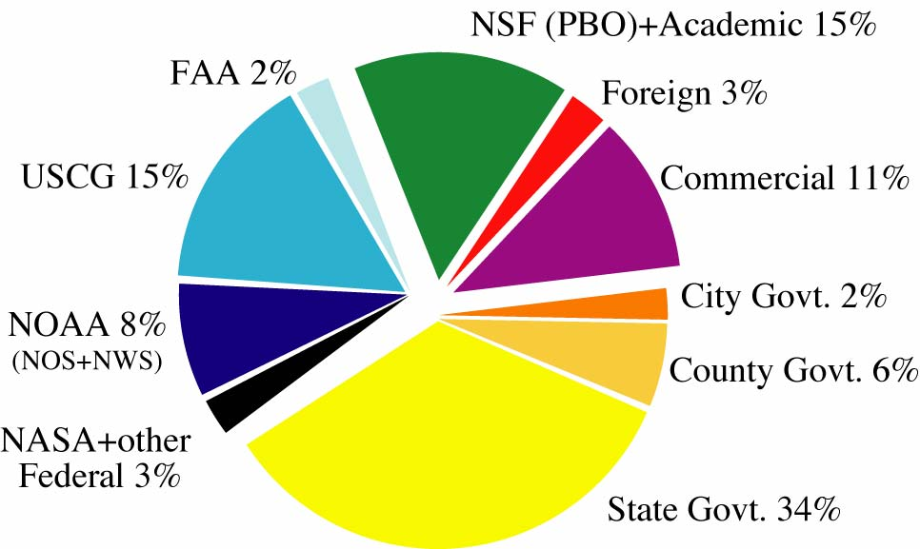
CORS Partners
Notes:
The more than 200 CORS partners include foreign, federal, state, and local government organizations, as well as academic and commercial institutions. NOAA itself operates only about 8% of the CORS sites.

Slide 8
Access to CORS Data
In Silver Spring, Maryland (CORS-East)
Anonymous File Transfer Protocol (FTP) ftp://cors.ngs.noaa.gov
UFCORS - User Friendly CORS http://www.ngs.noaa.gov/UFCORS
In Boulder Colorado (CORS-West)
Parallel and independent data collection and on-line storage at NOAA’s National Geophysical Data Center
Anonymous FTP ftp://wwwest.ngs.noaa.gov
Notes:
GPS data collected at CORS sites are transmitted to two separate locations: one in Silver Spring, Maryland; and the other in Boulder, Colorado. Data from most CORS are transmitted on an hourly basis to these two facilities. There are, however, many CORS sites whose data are transmitted only on a daily basis and others whose data are transmitted continuously in near real time. Users may obtain CORS data and metadata via the Internet by using the anonymous file transfer protocol (FTP) or via the World Wide Web by using the “user-friendly” CORS (UFCORS) utility. With anonymous FTP, a user obtains CORS information in the manner that this information is stored (what-you-see-is-what-you-get). With UFCORS, a user can “customize” the manner in which he/she receives CORS information. For example, with anonymous FTP, a user can only obtain GPS data at the sampling rate at which these data are stored (usually one reading every 30 seconds). On the other hand, with UFCORS, a user can specify what sampling rate he/she wants, and the UFCORS facility will either interpolate or decimate the stored GPS data to provide this user with data at his/her specified rate. (Actually, UFCORS allows only those rates, ranging between 1 second and 60 seconds, which either equal an integral divisor or an integral multiple of 30 seconds.)

Slide 9
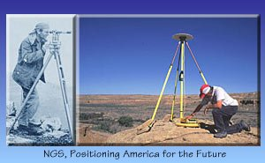
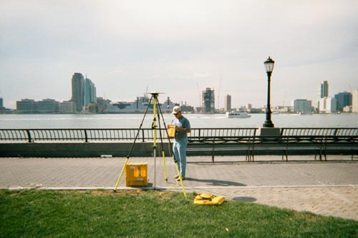
CORS Supports Precise Positioning
A
A
A
A
A
Before CORS: Accurate differential GPS positioning
with multi-person field crew.
After CORS: Accurate differential GPS positioning
with one-person field crew.
Notes:
The primary application of the CORS system is to support precise differential positioning. Prior to the existence of the CORS system, users would need to deploy at least two GPS receivers simultaneously to obtain centimeter-level positional coordinates. Using the CORS system, users can achieve the same level of accuracy by deploying only a single receiver and downloading corresponding CORS data via the internet.

Slide 10
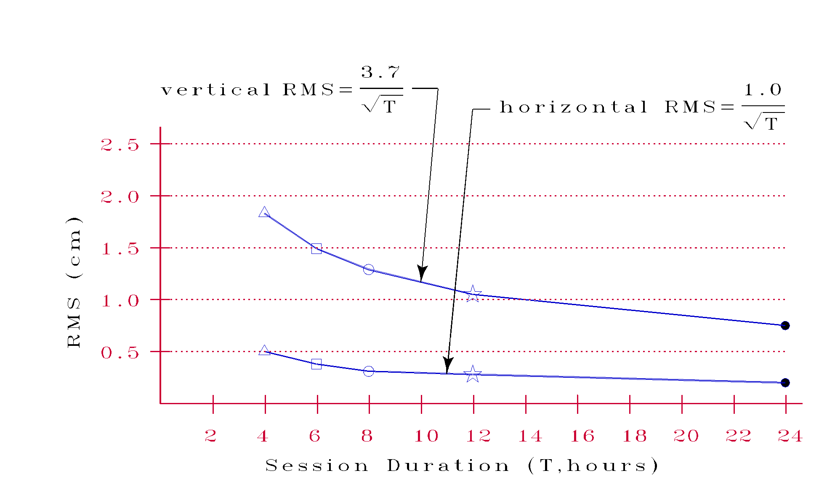
Positioning Error vs.
Duration of the Observing Session
Notes:
Studies performed in 1999 indicate that the standard error of computed horizontal coordinates, expressed in centimeters, may be approximated by the mathematical expression: one divided by the square root of the length of the observing session in hours. Similarly, these studies indicate that the standard error of computed vertical coordinates, again in centimeters, may be approximated by the mathematical expression: 3.7 divided by the square root of the length of the observing session in hours. Newer studies of achievable accuracies are now being conducted, and these studies indicate that the same level of accuracy can be obtained with shorter observing sessions, when the atmospheric conditions measured at CORS sites are interpolated to the location where the user collected his/her data.

Slide 11
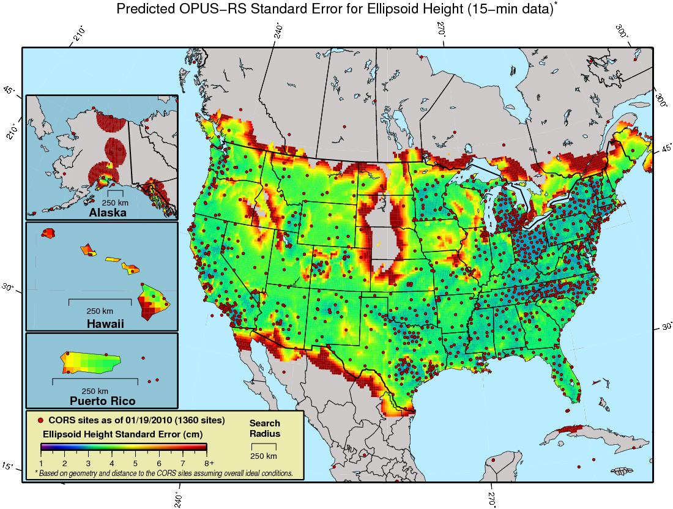
Vertical standard error achievable when a user submits 15 minutes of GPS data to OPUS-RS

Slide 12
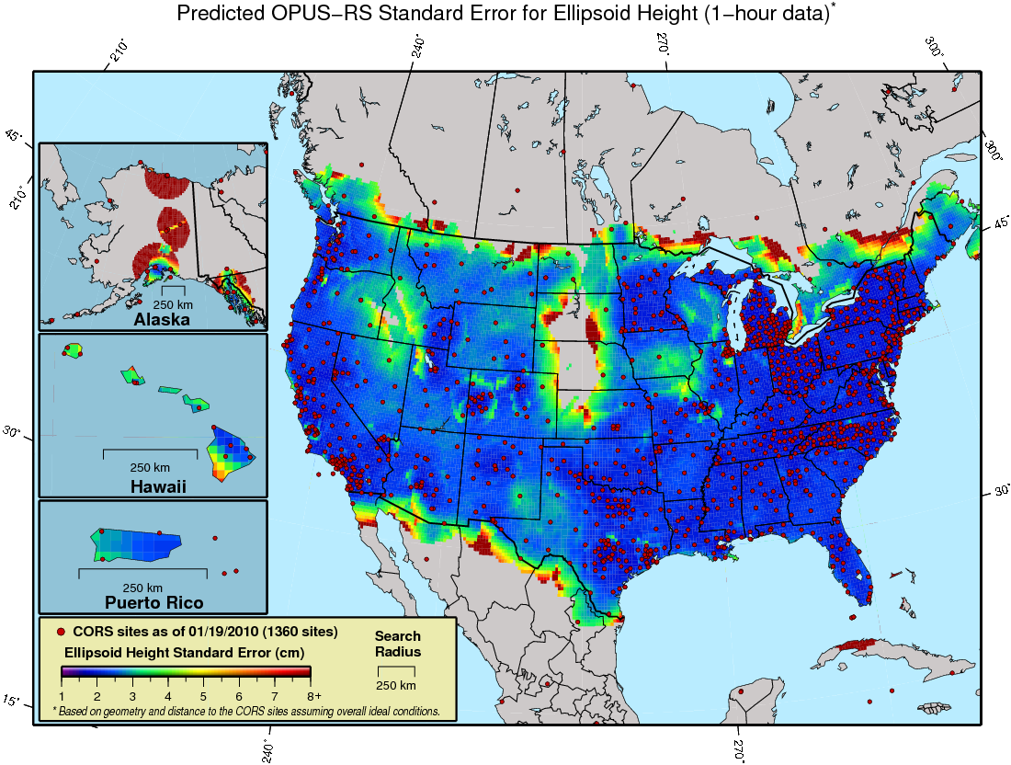
Vertical Standard error achievable when a user submits 1 hour of GPS data to OPUS-RS

Slide 13
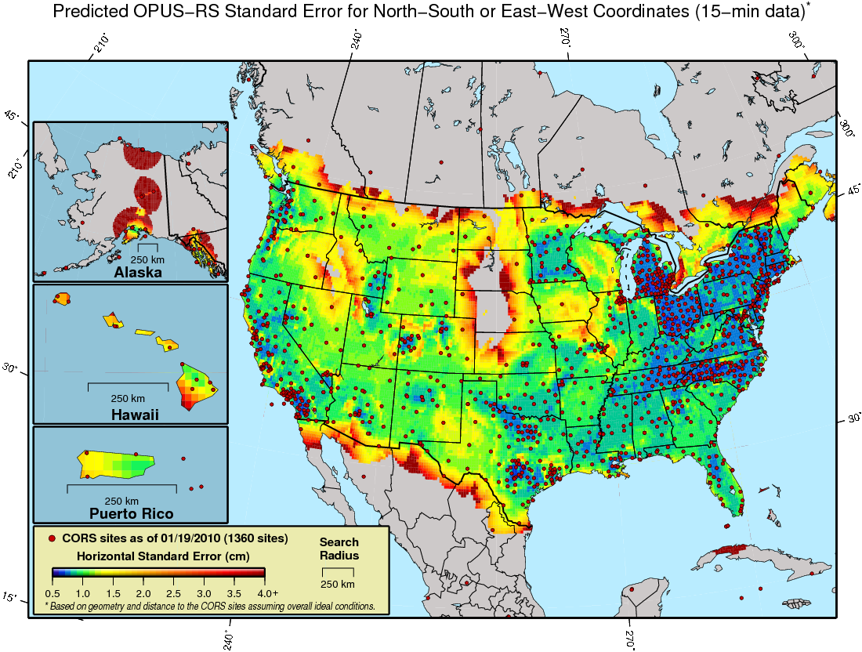
Horizontal standard error achievable when a user submits 15 minutes of GPS data to OPUS-RS

Slide 14
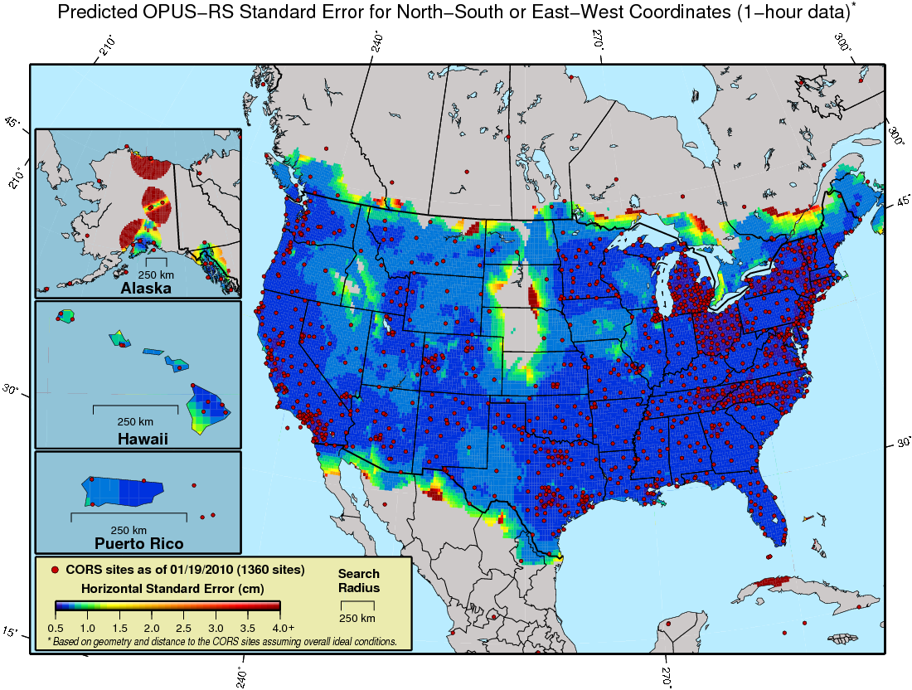
Horizontal standard error achievable when a user submits 1 hour of GPS data to OPUS-RS

Slide 15
Positioning Accuracy with Code Data
Observation Time = 1 minute
red = east-west
blue = north-south
RMS error = 25 cm + 2 ppm

Slide 16
Aircraft Positioning with CORS
Results using single CORS
3D RMS error = 15 cm + 0.6 ppm
aaaaaaaaaaaaaaaaaaaaaaaaaaaaaaaaaaaaaaaaaaaaaaaaaaa
aaaaaaaaaaaaaaaaaaaaaaaaaaaaaaaaaaaaaaaaaaaaaaaaaaaa

Slide 17
Online Positioning User
Service (OPUS)
● Collect at least 15 minutes of dual-frequency GPS data
Submit data to www.ngs.noaa.gov/OPUS/
Data are processed automatically using NOAA
computers & software
Corresponding positional coordinates computed
with respect to at least 3 suitable CORS or IGS sites
Computed coordinates returned via email
(usually in minutes)
Notes:
NOAA offers a free GPS-data-processing service, called the Online Positioning User Service or OPUS. An OPUS user must collect at least 15 minutes of dual-frequency GPS data and submit these data to NOAA via the OPUS web site (www.ngs.noaa.gov/OPUS/ ). The OPUS utility will then process these data automatically with respect to the data from 3 CORS (or IGS sites) to compute 3-dimensional positional coordinates for the location where the submitted data were collected. OPUS will then send the user an email that contains the computed coordinates, usually a few minutes after the data were submitted.

Slide 18
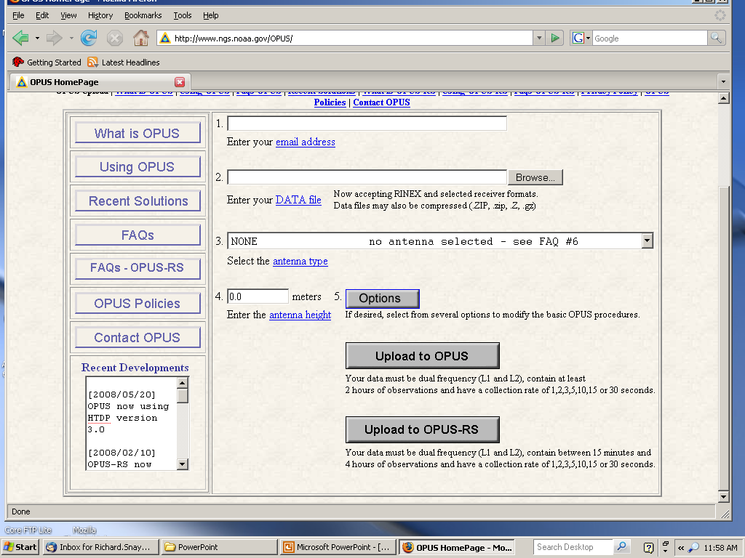

Slide 19
OPUS Output
FILE: corv0590.05o 000416827
1008 NOTE: Antenna offsets supplied by the user were zero. Coordinates
1008 returned will be for the antenna reference point (ARP).
1008
NGS OPUS SOLUTION REPORT
========================
USER: jeff.olsen@noaa.gov DATE: January 13, 2006
RINEX FILE: corv059f.05o TIME: 19:08:14 UTC
SOFTWARE: page5 0601.10 master3.pl START: 2005/02/28 05:00:00
EPHEMERIS: igs13121.eph [precise] STOP: 2005/02/28 06:59:30
NAV FILE: brdc0590.05n OBS USED: 4228 / 4314 : 98%
ANT NAME: ASH700936B_M NONE # FIXED AMB: 25 / 29 : 86%
ARP HEIGHT: 0.0 OVERALL RMS: 0.013(m)
REF FRAME: NAD_83(CORS96)(EPOCH:2002.0000) ITRF00 (EPOCH:2005.1596)
X: -2498423.165(m) 0.018(m) -2498423.872(m) 0.018(m)
Y: -3802822.048(m) 0.021(m) -3802820.836(m) 0.021(m)
Z: 4454737.695(m) 0.024(m) 4454737.792(m) 0.024(m)
LAT: 44 35 7.91054 0.002(m) 44 35 7.92698 0.002(m)
E LON: 236 41 43.48129 0.014(m) 236 41 43.42434 0.014(m)
W LON: 123 18 16.51871 0.014(m) 123 18 16.57566 0.014(m)
EL HGT: 107.485(m) 0.034(m) 107.108(m) 0.034(m)
ORTHO HGT: 130.010(m) 0.043(m) [Geoid03 NAVD88]
UTM COORDINATES STATE PLANE COORDINATES
UTM (Zone 10) SPC (3601 OR N)
Northing (Y) [meters] 4936954.907 105971.557
Easting (X) [meters] 475821.322 2277335.385
Convergence [degrees] -0.21381402 -1.98897497
Point Scale 0.99960719 0.99994603
Combined Factor 0.99959034 0.99992918
US NATIONAL GRID DESIGNATOR: 10TDQ7582136955(NAD 83)
BASE STATIONS USED
PID DESIGNATION LATITUDE LONGITUDE DISTANCE(m)
AH2489 NEWP NEWPORT CORS ARP N443506.072 W1240342.736 60138.7
AJ6959 CHZZ CAPE MEARS CORS ARP N452911.437 W1235841.187 113322.4
DH4503 P376 EOLARESVR_OR2004 CORS ARP N445628.313 W1230608.100 42648.2
NEAREST NGS PUBLISHED CONTROL POINT
AH2486 CORVALLIS CORS ARP N443507.910 W1231816.519 0.0
NAD 83 coordinates (3D)
ITRF coordinates (3D)
NAVD 88 height
State Plane coordinates
UTM coordinates
US National Grid
A more comprehensive
output is also
available upon
request.
Notes:
WHAT DOES THE OPUS OUTPUT LOOK LIKE
OPUS was designed to be a one page document that was simple and easy to read.
There’s basically three sections to the it.
The first part is information about the dataset you submitted and the software used.
Here I would check your antenna name and the height you entered.
If you don’t have the correct antenna, well, you know.
Over here, you have the number of possible observations vs the number used, you want to be in, say the 90% range.
Next is the number and ratio of fixed ambiguities and again I like to see this number pretty high at least around 80% if not better.
And I like the overall RMS to be under three.
The second part is the meat and potatoes, the coordinates you were looking for.
You have your NAD83 (CORS96) position reported at the 2002.0 epoch and ITRF00 coordinates at the epoch of the midpoint of your data.
Coordinates are reported in both the Cartesian xyz, and geodetic coordinates systems.
The Orthometric ht. is based on the current geoid model.
You have your UTM coordinates, your US National Grid Designator, and your State Plane coordinates if you chose that option.
Do you remember I said that OPUS performs 3 independent solutions?
These numbers to the right of the solution are Peak to Peak errors.
They are shown for both coordinates systems and may differ between the two.
Peak to peak errors are the difference between the max and min values of the 3 individual solutions.
These numbers are indicative of the CORS that were used in the processing.
If you have large peak to peaks, say over 4 or 5 cm or so, I would try to determine which CORS is the problem by selecting different ones.
Hopefully in the future we will have a “do not use” menu much as there is a choice menu.
And the third part lists which Base Stations were used in the solution along with their position and the distance from the GPS station being solved for.
The closest published station is shown, and in this case, it is itself since this is a published CORS.
And of course the ever more popular disclaimer is at the bottom of every solution.
Now I want you to notice that this solution used the precise orbits.

Slide 20
OPUS add-ons
DEFAULT OPTION OPUS FLAVOR
US only global results OPUS-global
hours of data minutes of data OPUS-RS
no archive share results OPUS-DB
one receiver multiple receivers OPUS-projects
no delimiters delimited results OPUS-XML
GPS only GNSS signals OPUS-GNSS
Notes:
OPUS Database
Stream-lined method for users to publish their results
User registration - ID & password, Validation process,
OPUS solutions can be integrated into the NGS database
Data elements from OPUS , Additional metadata
Submission review by user and NGS
OPUS Projects
Managers can define a project
Process any number of stations under a project, Project can span several days to weeks, Contract work
Project processing
Each dataset sent to OPUS but identified with a project, Results returned to submitter a few minutes later, Manager can monitor processing and submission
Final adjustment
Entire project adjusted as one campaign, Review & submission to NGS
OPUS Rapid Static
User requests, Single frequency capability, Rapid static solutions (10 – 15 minutes of data), Will be processed with carrier phases
Accurate to several centimeters, Need more accurate ionospheric and tropospheric modelling In development at OSU and NGS
OPUS GIS
Compute a differential pseudorange solution for less expensive GPS receivers
Aimed at the GIS community who do not require cm level accuracies
Allows processing in a consistent approach and “certify” their locations in the NSRS
Generate rapid static solution from seconds or minutes of data
Accuracies: A few decimeters to a meter horizontally
Pilot project underway in Phoenix, Arizona

Slide 21
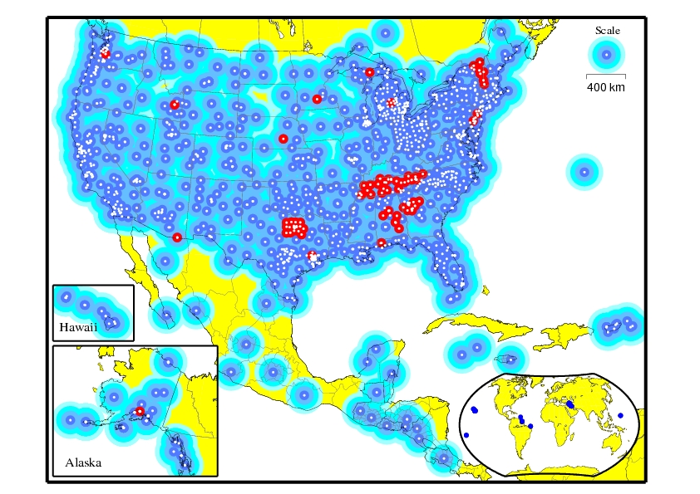
Just Around the Corner
Within the next 12 months, the CORS system will:
Provide GPS L2C data
Provide GLONASS data
Broadcast GNSS data via the Internet in real-time (on an experimental basis). (For selected sites only.)
Red dots identify locations of CORS sites
that collect both GPS and GLONASS data.
Notes:
Starting later in 2008, the CORS system will provide GPS L2C data. Also, the CORS system will provide GLONASS data. The map identifies in red those CORS sites that collect both GPS and GLONASS data. Also, the CORS system will broadcast GNSS data via the Internet from selected CORS sites. Currently, GNSS data are being broadcast from three CORS sites on an experimental basis.

