Slide 1
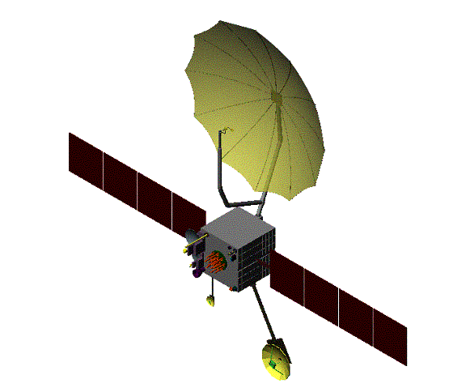
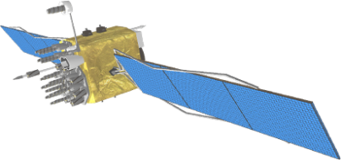
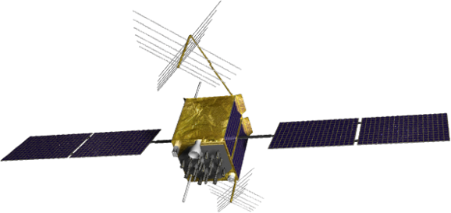
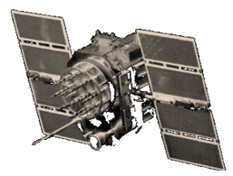
GPS Status and Modernization
Capt Damon Smith
PNT Requirements Division
Air Force Space Command
"DISTRIBUTION A: Approved for public
release; distribution unlimited"
"This briefing is for information only. No US Government commitment to
sell, loan, lease, co-develop or co-produce defense articles or provide
defense services is implied or intended."

Slide 2
Overview
GPS Overview
Recent Events
Modernization Improvements

Slide 3

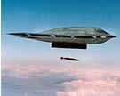



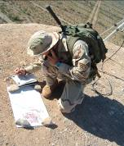


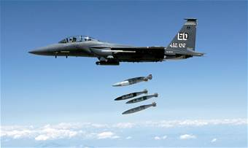
Critical Asset
Vital to International Security, Economic Growth, and Public Safety
Extends across all domains -- air, land, sea, space, cyberspace
Effects transcend national and military boundaries
Available, reliable, accurate, and free of charge

Slide 4
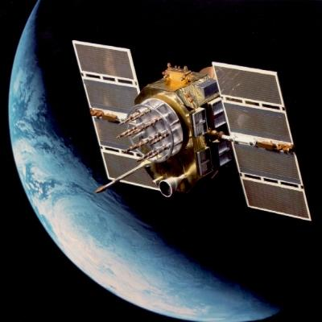
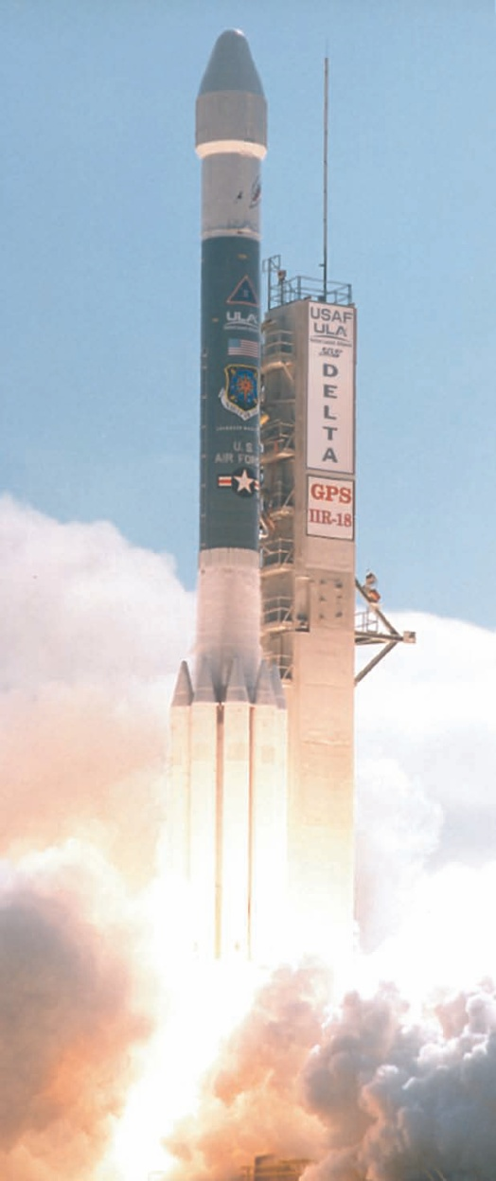
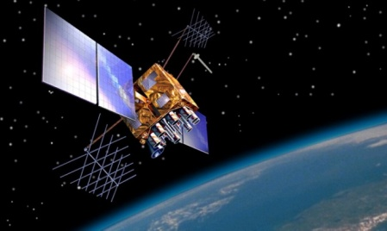
GPS – Serving the World
Very robust constellation
  31 satellites currently in operation
    11 GPS IIA
    12 GPS IIR
    7 GPS IIR-M
  3 additional satellites in residual status
  1 additional IIR-M waiting to be set healthy
Global GPS civil service performance
commitment met continuously
since December 1993
Next Launch – IIF-1, May 2010

Slide 5

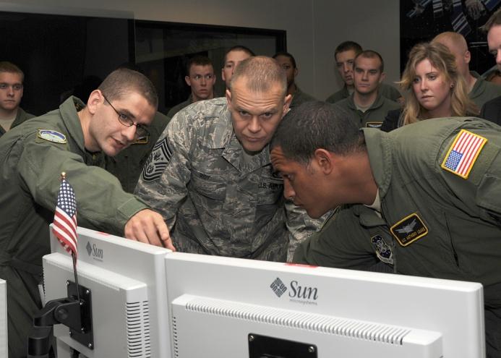
GPS Control Segment
Operated by Space Professionals in 2d Space Operations Squadron at Schriever AFB, CO
Backup facility at Vandenberg AFB, CA
Global monitoring and antenna networks
Alaska
Schriever AFB
England
Vandenberg
AFB
USNO Wash, DC
South Korea
Bahrain
Hawaii
Cape Canaveral
Ecuador
Diego Garcia
Kwajalein
Tahiti
Ascension
Argentina
South Africa
Australia
New Zealand

Slide 6
SPS Signal in Space Performance
N/A
N/A
N/A
N/A
N/A
2001 SPS Performance Standard
(Root Mean Square (RMS) over all SPS SIS URE)
2008 SPS Performance Standard
RMS Signal-in-Space User Range Error (URE), meters
(RMS over all SPS SIS URE)
Selective Availability
System accuracy exceeds published standard

Slide 7
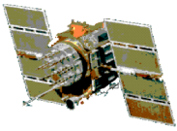


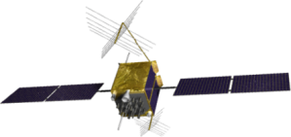
GPS Modernization –
Space and Control Segments
1995
2005
2010
2014 - 2025
GPS IIA
GPS II R / IIR-M
GPS IIF
GPS III
Space
Segment
Standard Service
  Single frequency (L1)
  Coarse acquisition code navigation
Precise Service
  Y-Code (L1Y & L2Y)
IIA/IIR capabilities plus
2nd civil signal (L2C)
M-Code (L1M & L2M)
IIR-M capability plus
3rd civil signal (L5)
12 year design life
Backward compatible
4th civil signal (L1C)
Increased accuracy
Increased integrity
Legacy
Control
System
Architecture Evolution Plan
(AEP)
Next Generation
Control Segment
(OCX)
Control Segment

Slide 8
GPS Modernization – Ground
Architecture Evolution Plan (AEP)
  Transitioned in 2007
  Modern distributed system replaced 1970’s mainframes
  Increased capacity for monitoring of GPS signals
  Increased worldwide commanding capability
Next Generation Control Segment (OCX)
  Controls more capable GPS constellation
  Monitors all GPS downlink signals
  $1.5B contract awarded 25 February 2010

Slide 9
GPS Modernization – New Civil Signals
Second civil signal “L2C”
  Designed to meet commercial needs
  Higher accuracy through ionospheric correction
  1st launch: Sep 2005 (GPS IIR-M); 24 satellites: ~2016
Third civil signal “L5”
  Designed to meet demanding requirements for transportation safety-of-life
  1st launch: ~ 2010 (GPS IIF); 24 satellites: ~2018
Fourth civil signal “L1C”
  Designed with international partners for GNSS interoperability
  Begins with GPS Block III
  1st launch: ~2014; 24 satellites: ~2021

Slide 10
GPS Expandable
Optimize GPS assets to improve operational effectiveness for global users & terrain challenged environments
  Increase the number of vehicles over head for better availability/coverage
  Constellation expansion feasible with robust number of satellites now on-orbit
Consistent with the current Standard Positioning Service (SPS) Performance Standard
  Adjust position of satellites in 3 of 6 orbital planes to create expanded constellation
  Expanded constellation provides better GLOBAL coverage

Slide 11
Summary
Largest DoD constellation in history with best accuracy ever
Modernized Command and Control System allows more signal monitoring and quicker satellite commanding than ever before
Constant improvements through constellation management
And we’re continuing to modernize and improve GPS even more!
GPS -- Serving the World

Slide 12
GPS Status and Modernization
PNT Requirements Division
Air Force Space Command

