Slide 1


ADVANCEMENTS in GPS & AERIAL PHOTOGRAPHY
DeLane R. Meier PE/LS
Surveys & Photogrammetry
GIS Intermountain Conference Meeting
Bozeman, MT
April, 2010

Slide 2
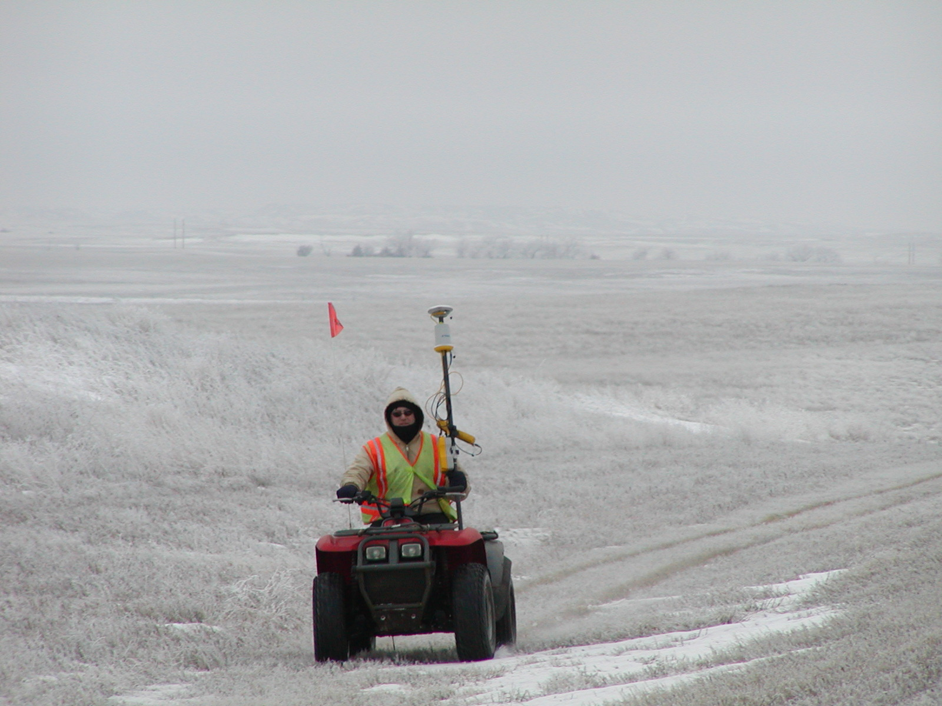
We surveyed in all types of weather, riding on an ATV & UTV … or

Slide 3
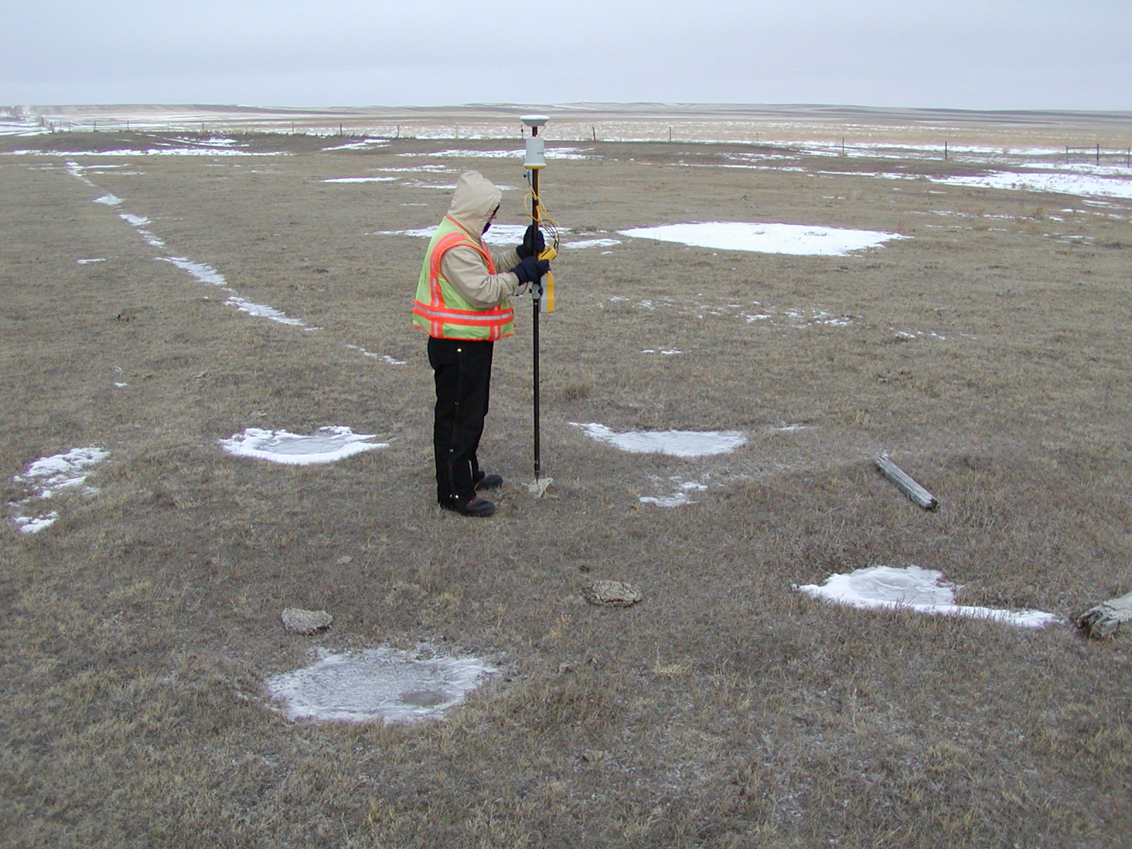
… walking

Slide 4
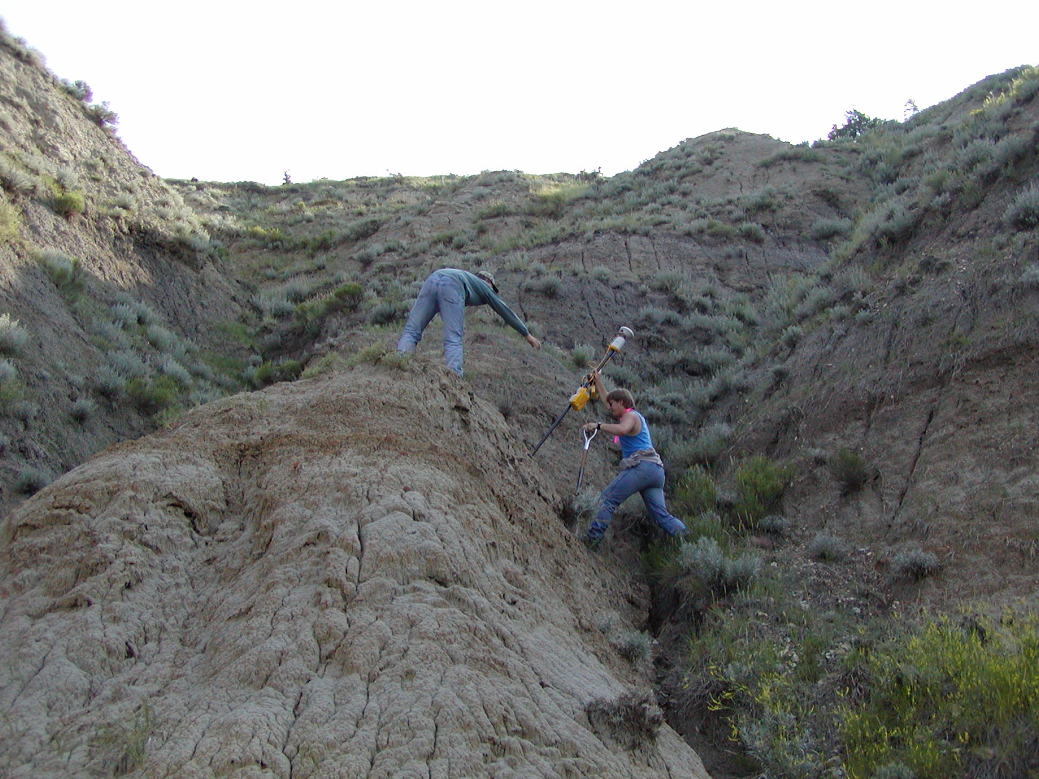
We surveyed in all types of terrain

Slide 5
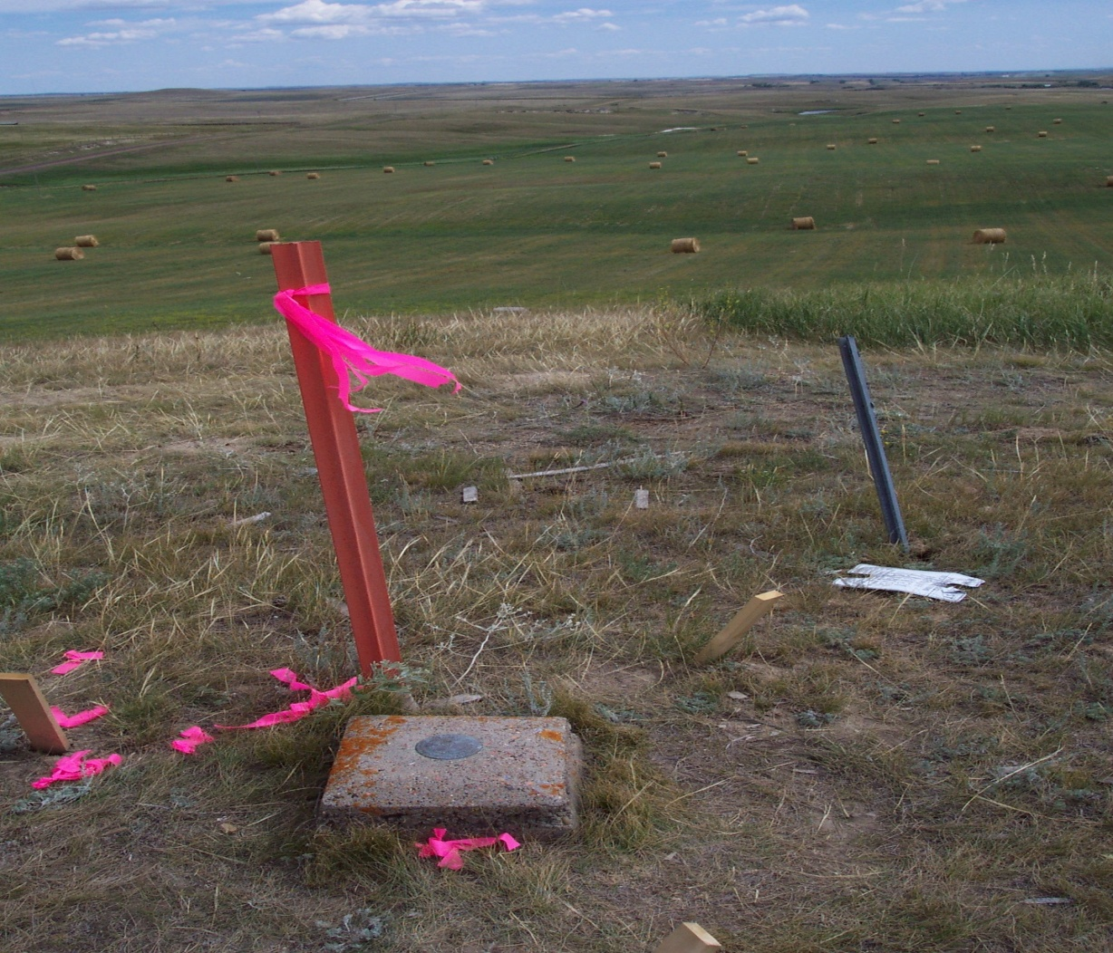
Horizontal & Vertical monuments were used in all of our surveys

Slide 6
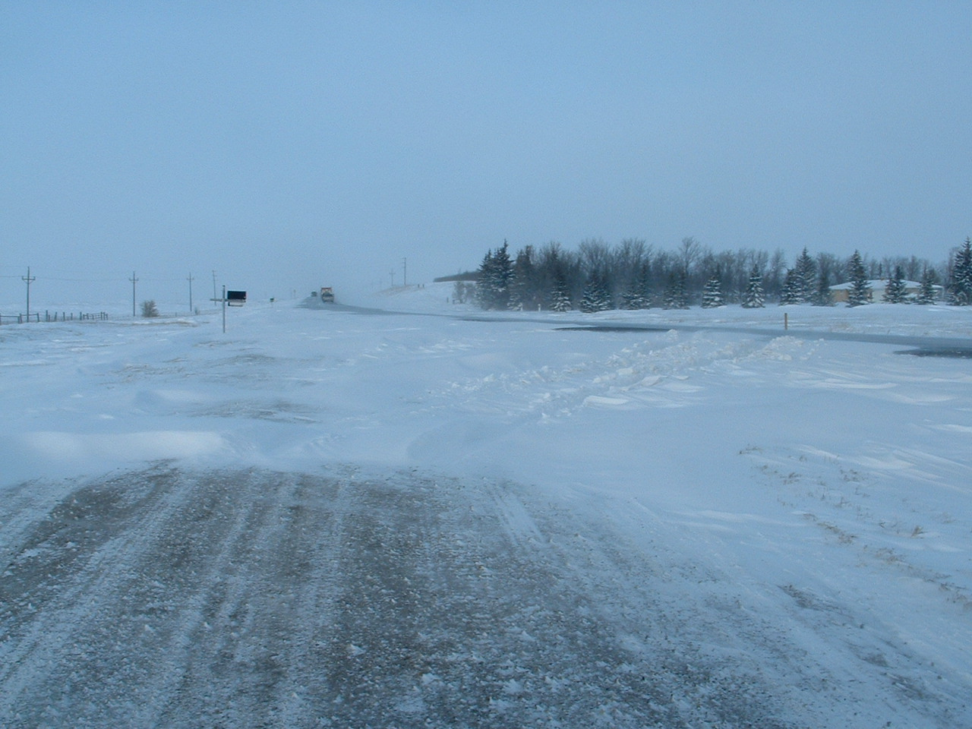
ND 8 north of Stanley, ND

Slide 7
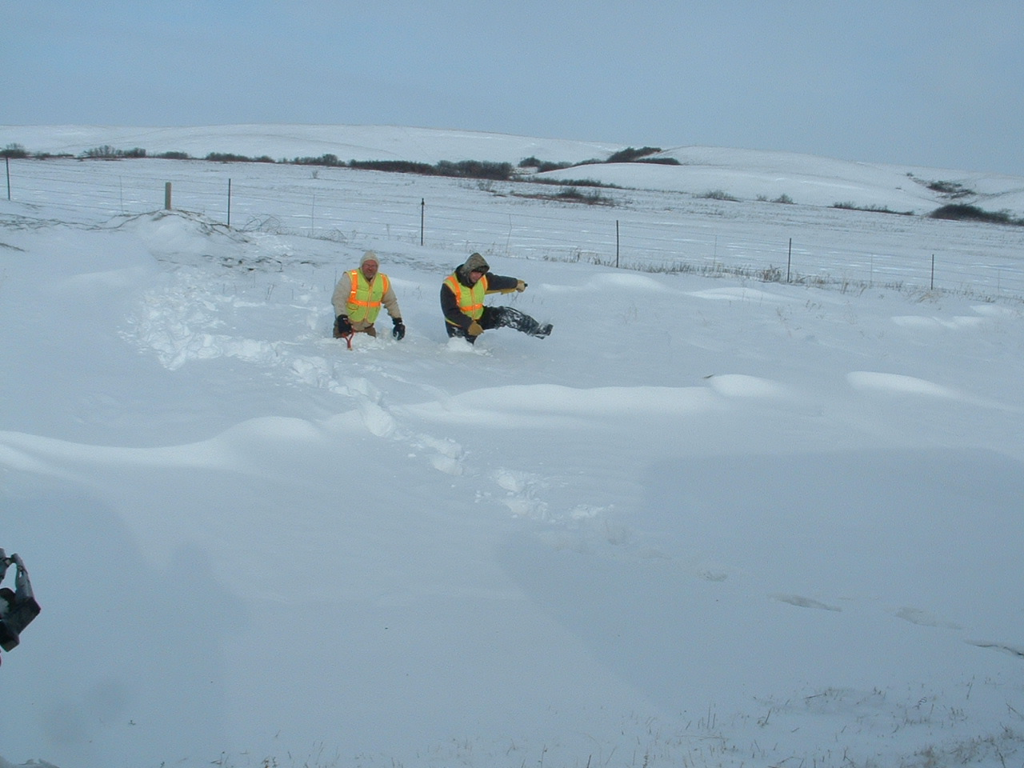
Surveying the hard way

Slide 8
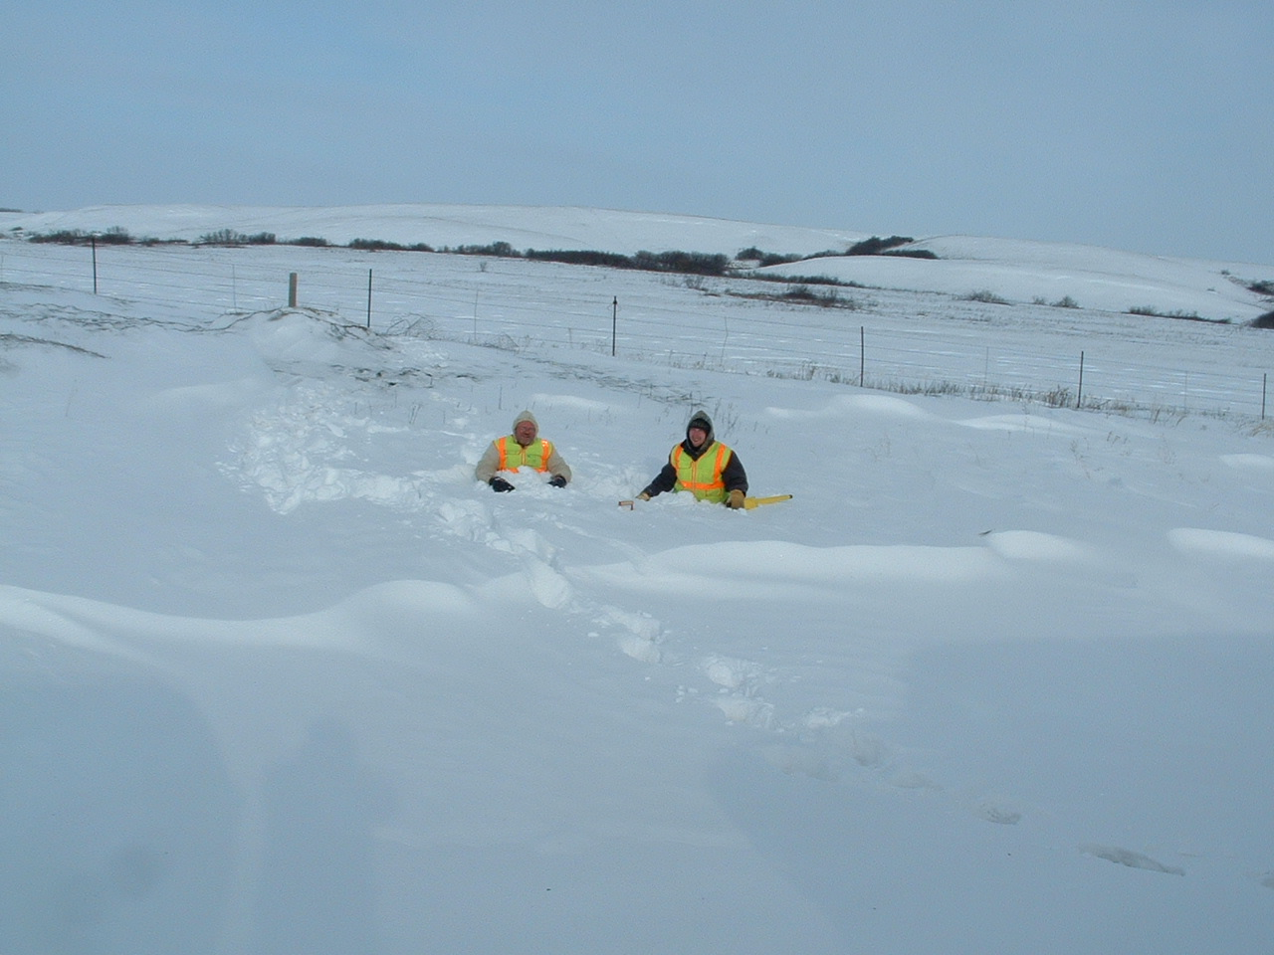
How deep is the snow?

Slide 9
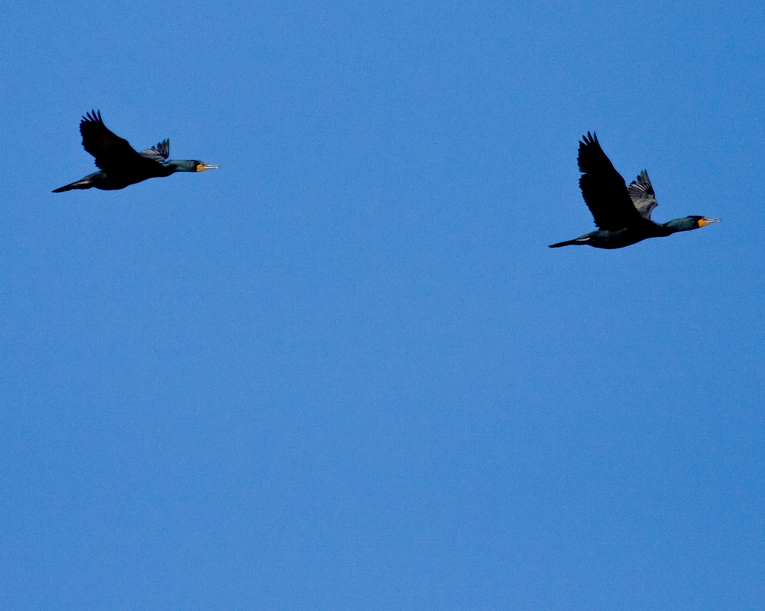
What do they see?
Lets go see!
There goes the SkyMaster.
I wonder what the NDDOT is up to today ?

Slide 10
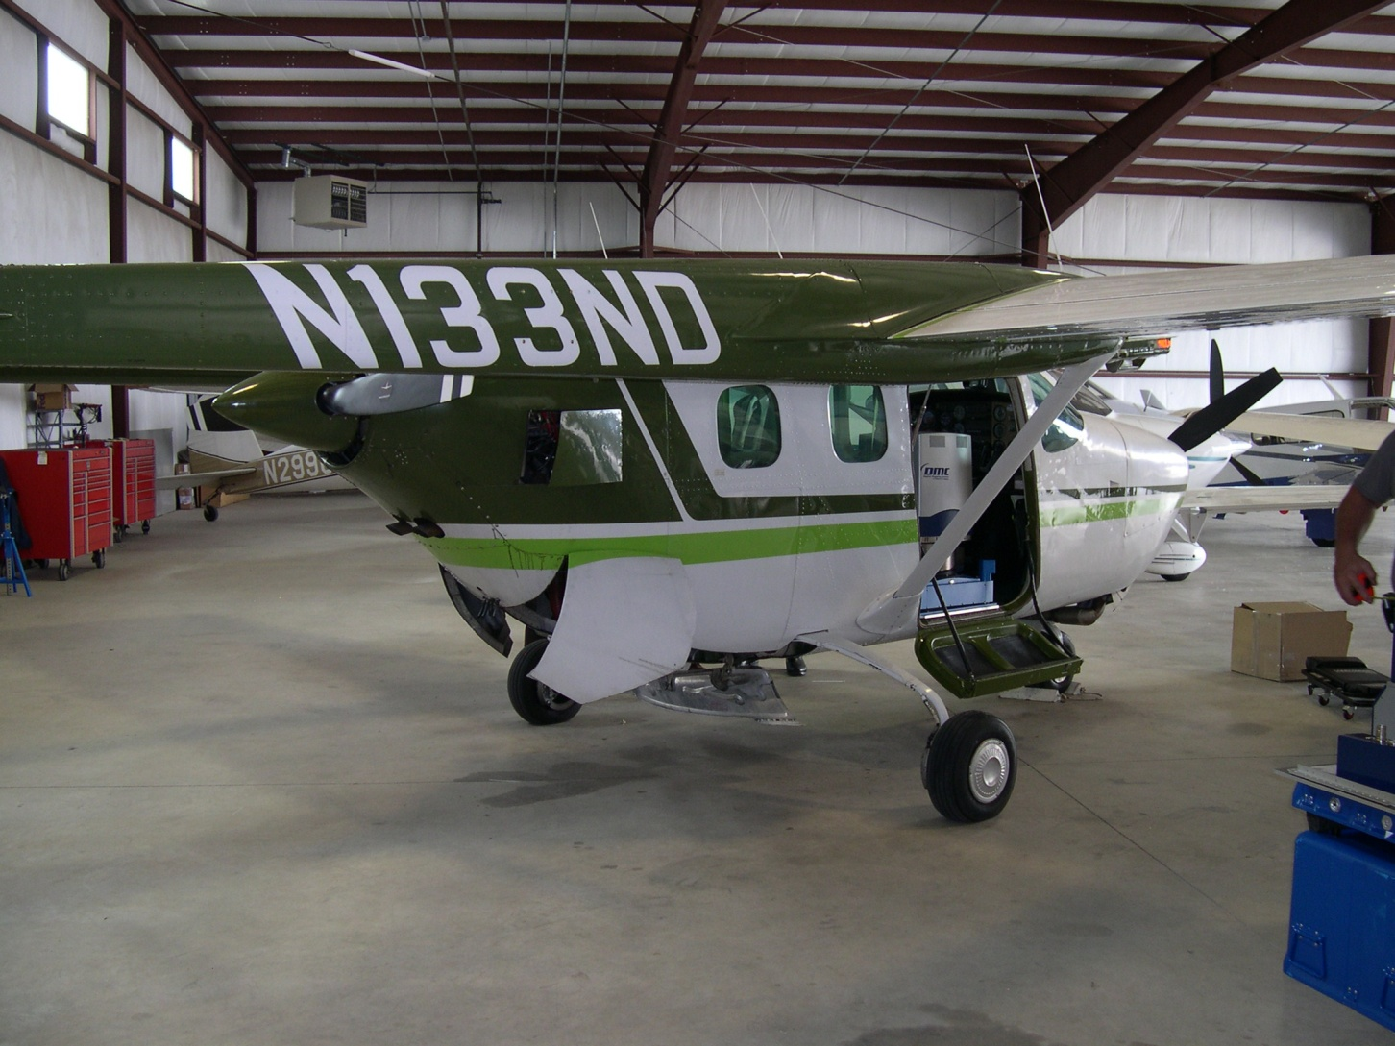

SkyMaster airplane with Digital Aerial Camera

Slide 11
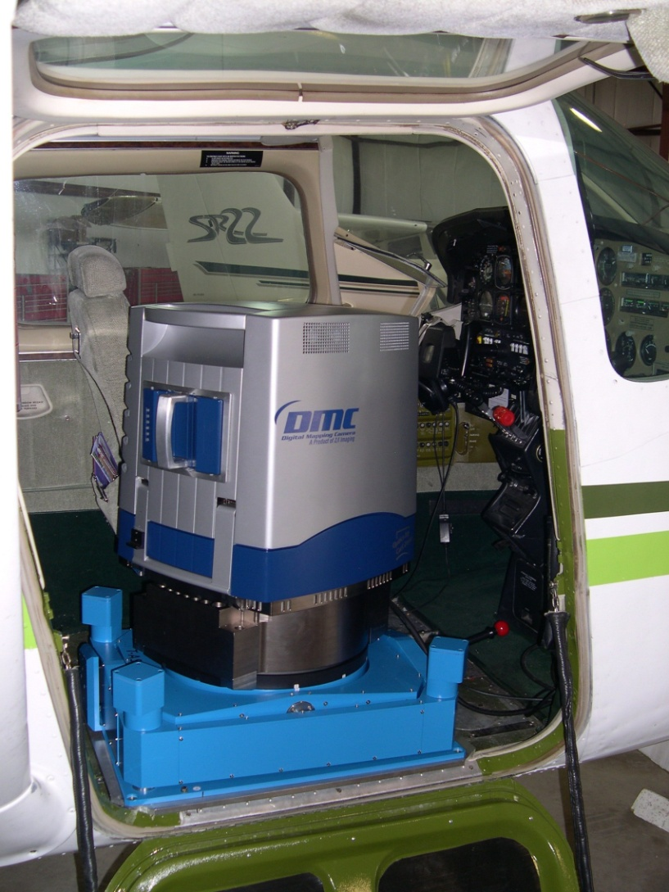

DMC in the airplane

Slide 12
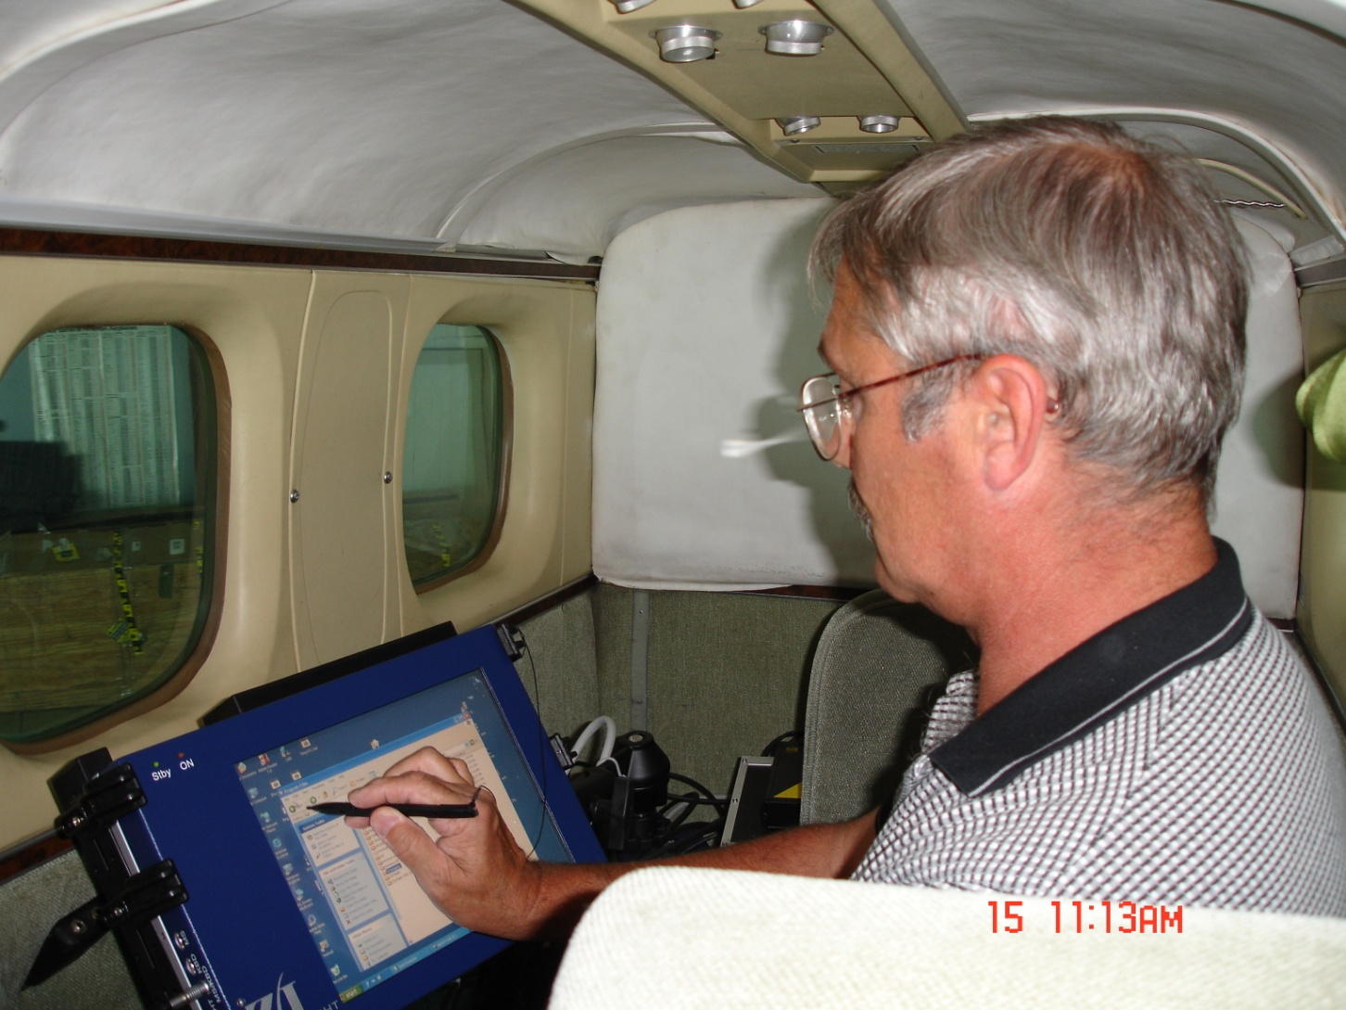
Cameraman using the Display

Slide 13
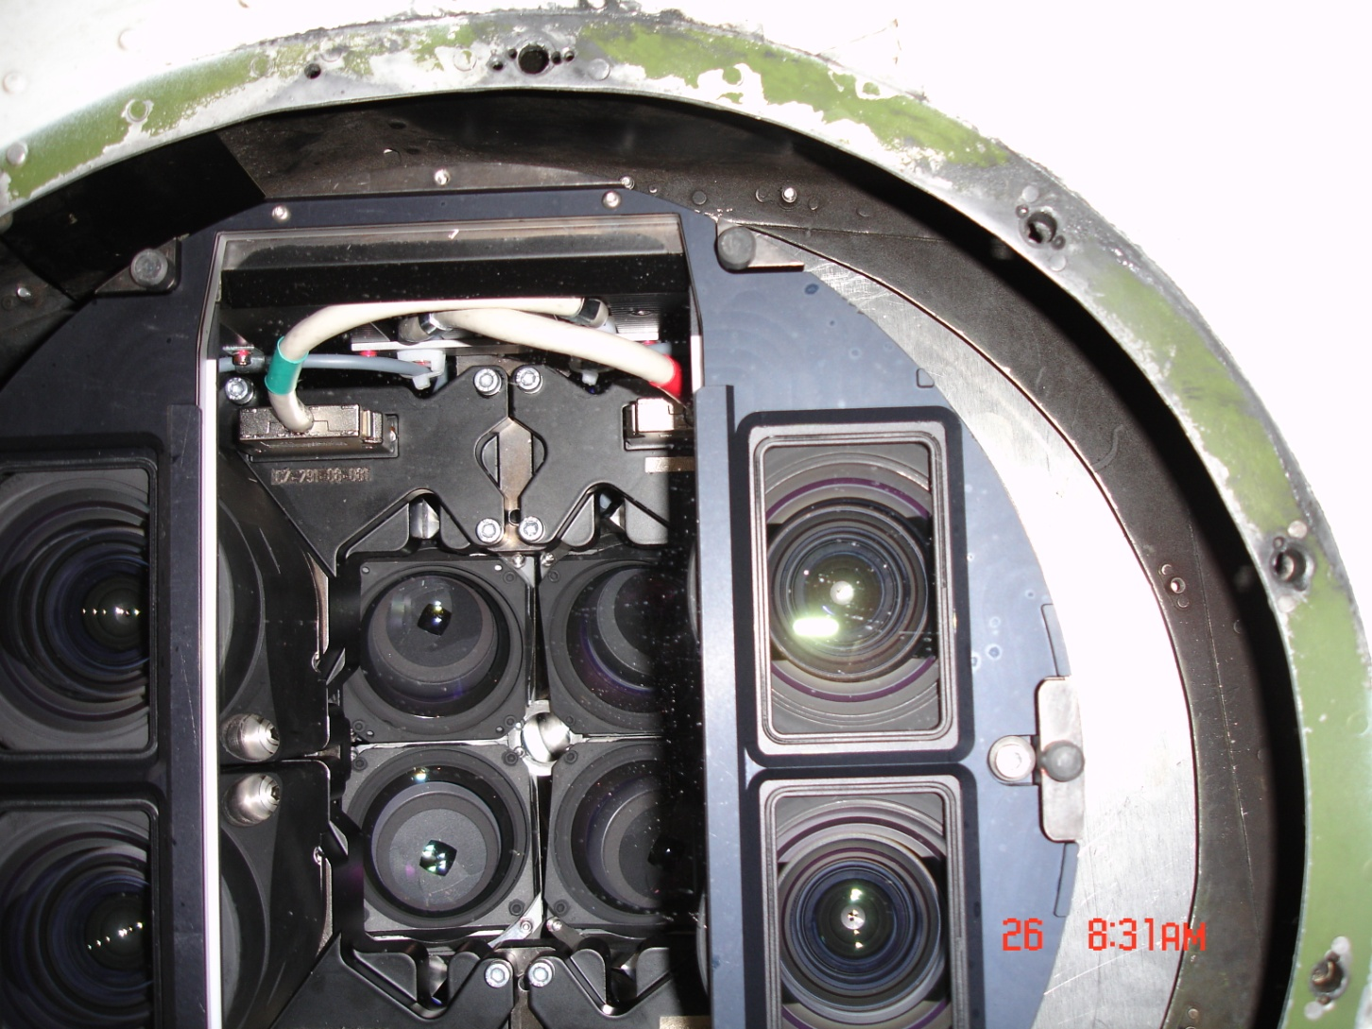
Bottom of the Camera

Slide 14
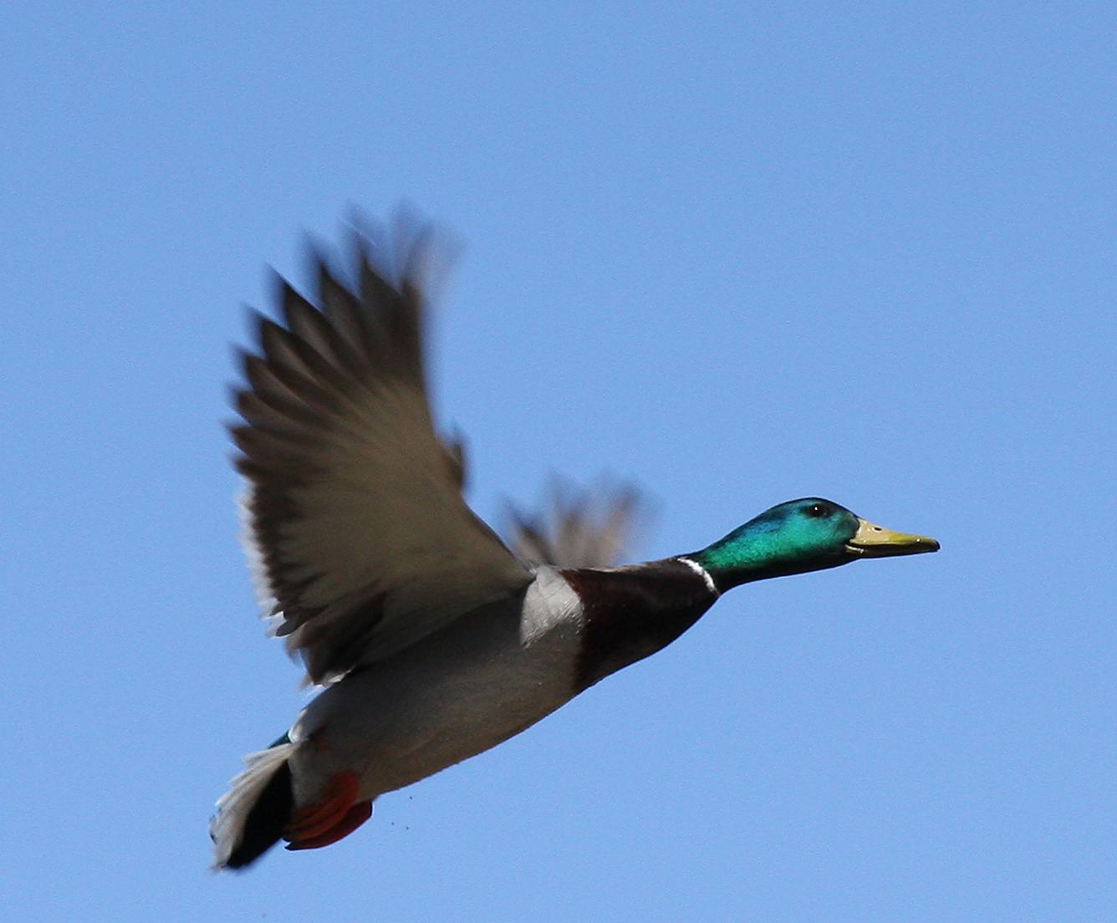

Processing in the office
That’s cool. What do they do with the Digital data?

Slide 15
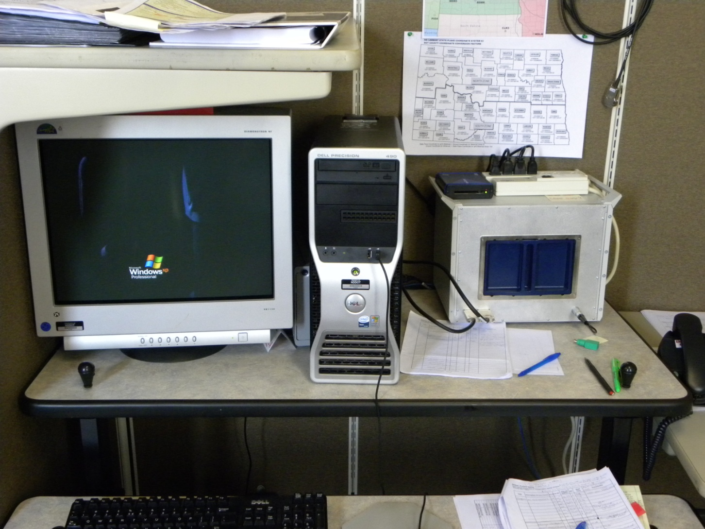
Digital Image Processer Station

Slide 16
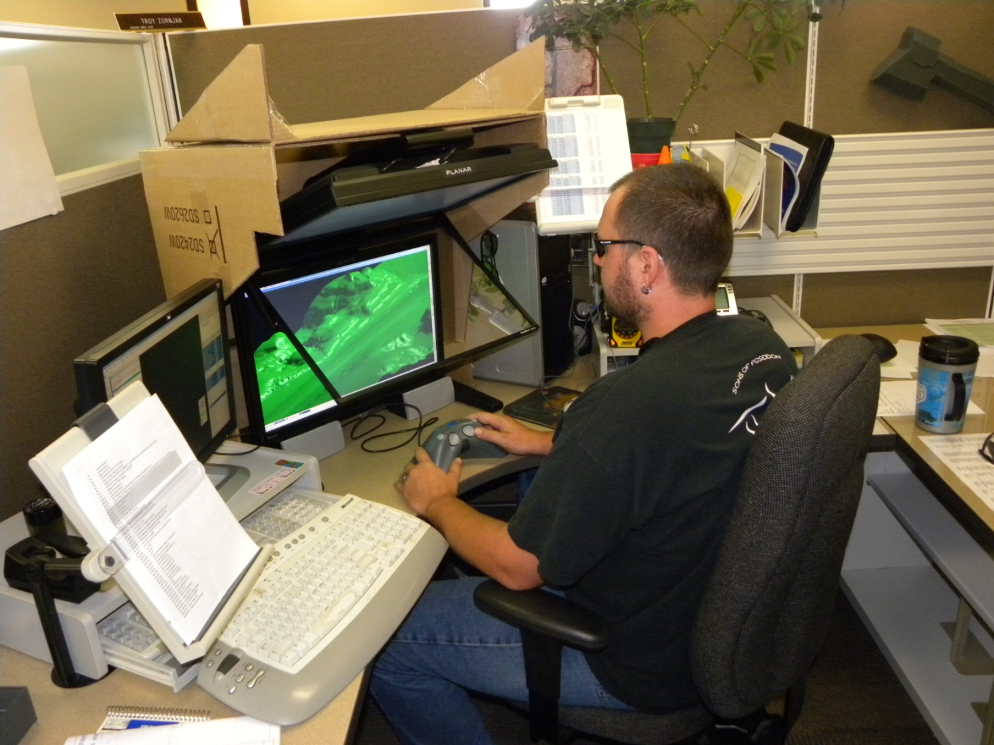
SSK Stereoplotter

Slide 17
NDGPS and Non-control
How does NDGPS work with non-controlled photos?

Slide 18
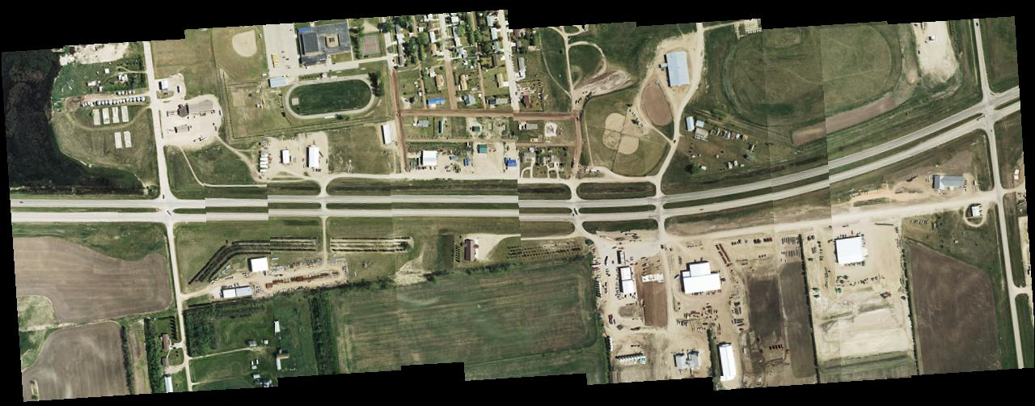
Non-Controlled Mosaic

Slide 19
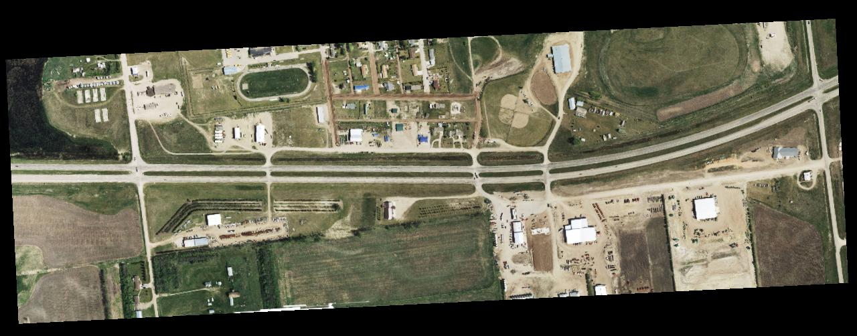
Controlled Mosaic

Slide 20
Before and after

Slide 21
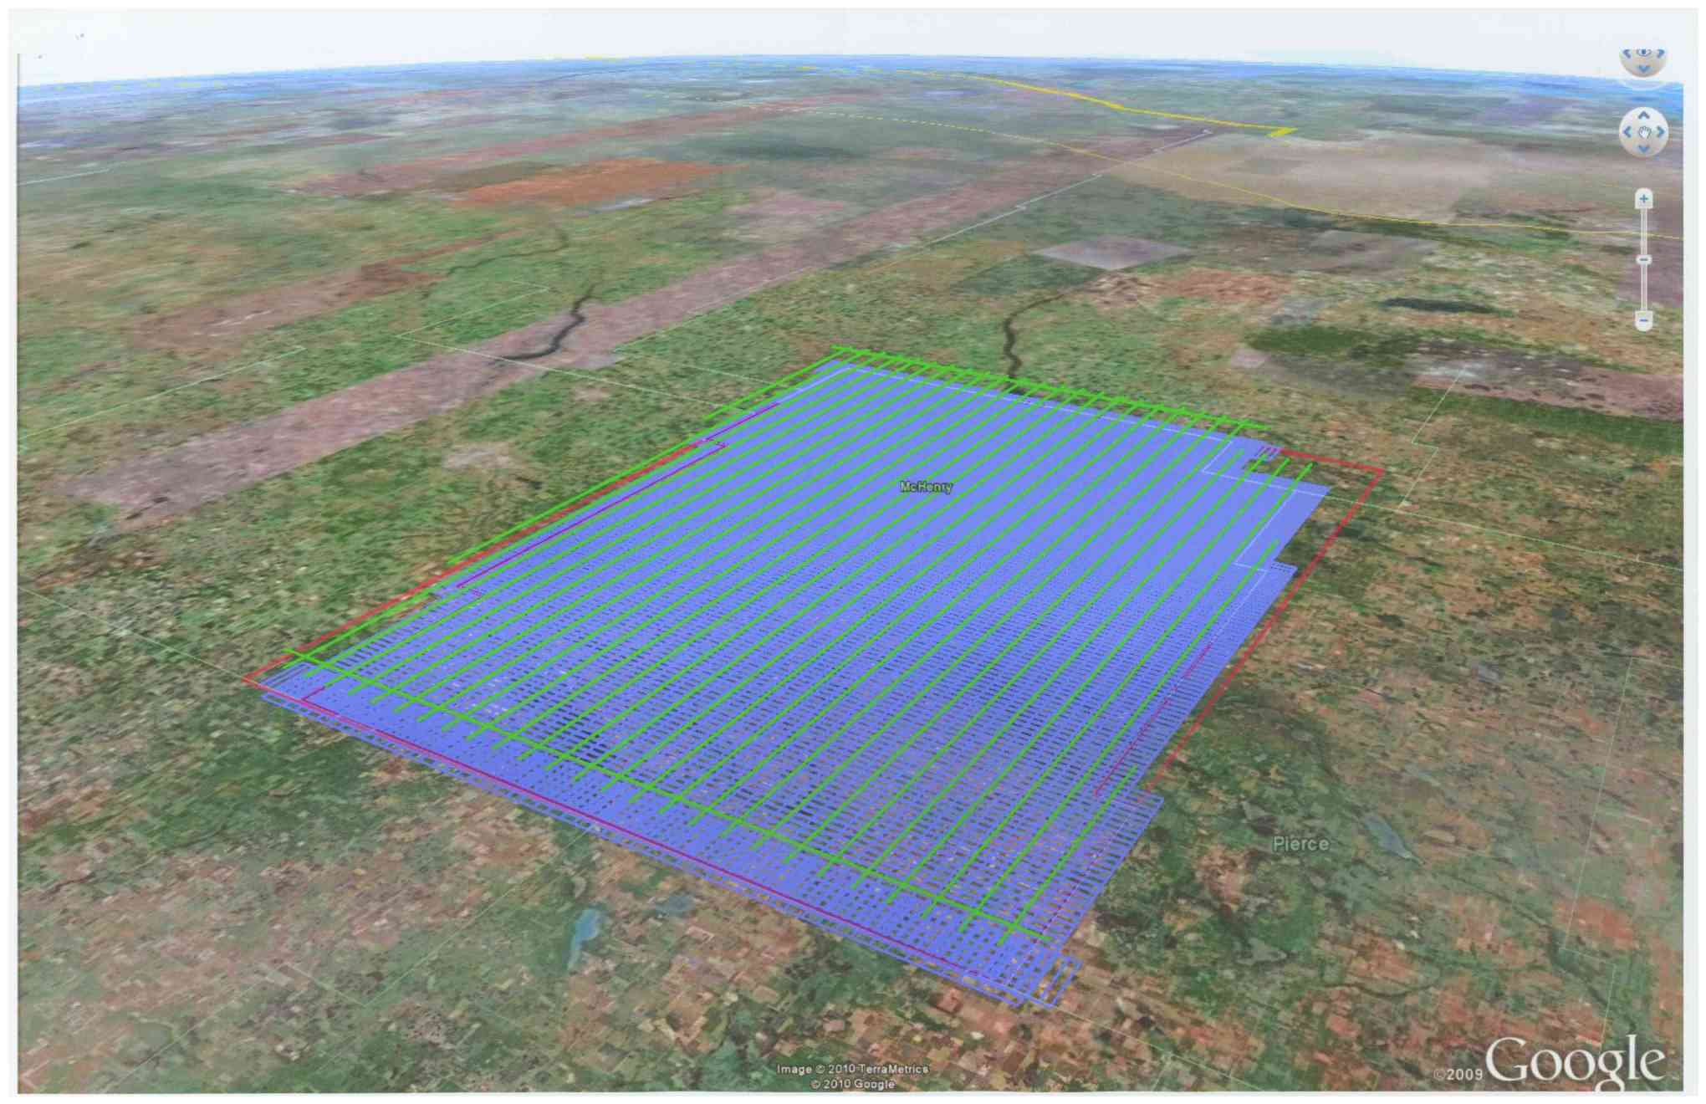
McHenry CO. Mission flight lines

Slide 22
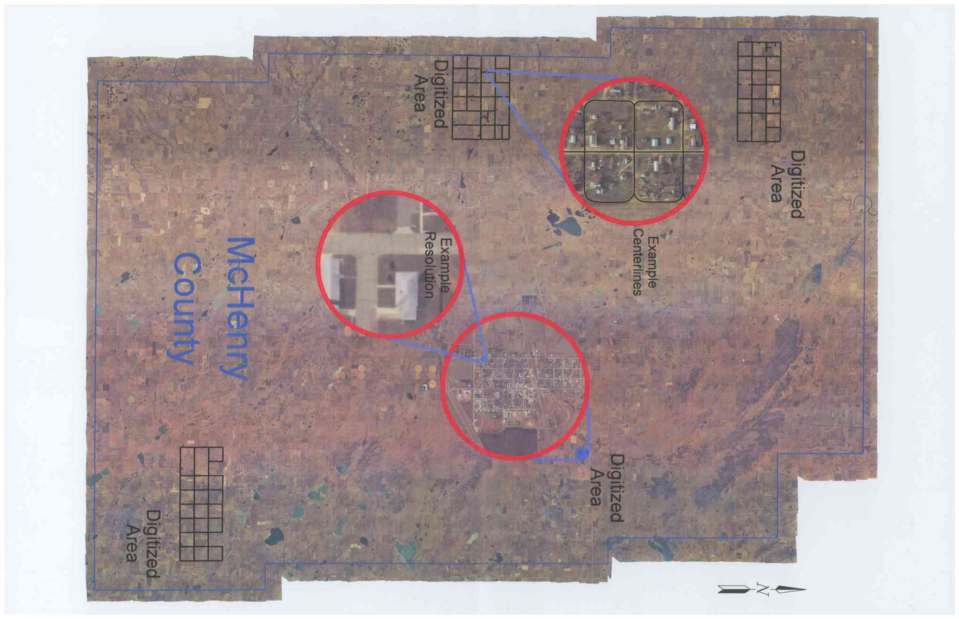
McHenry County Final product

Slide 23
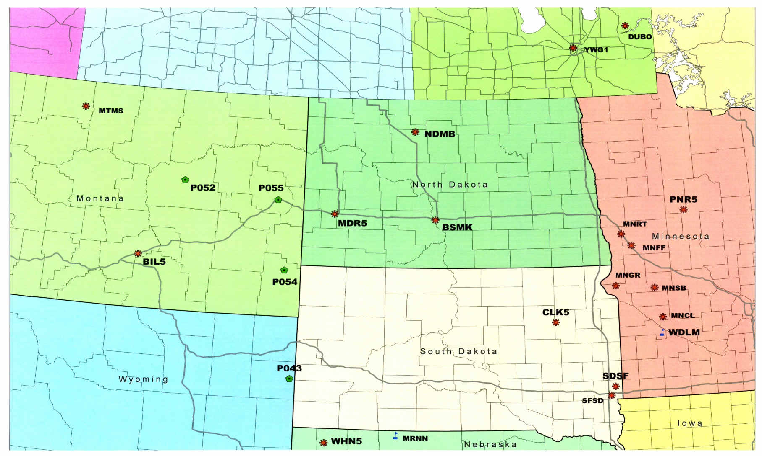
NDGPS Network in North Dakota area

Slide 24
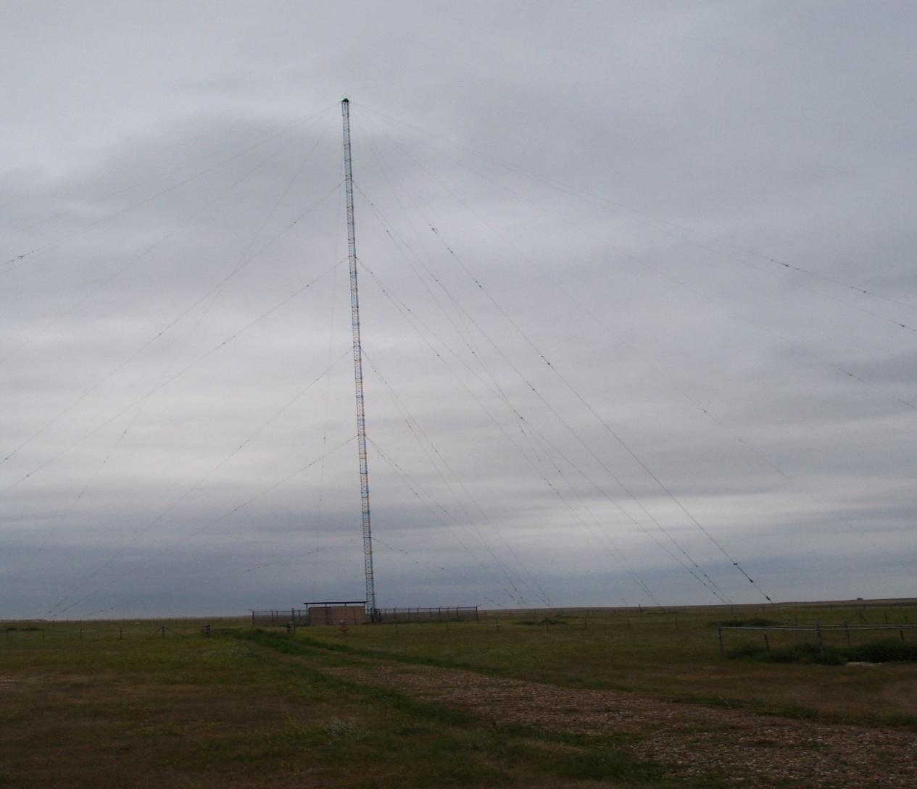
STATION MEDORA
(the tower)

Slide 25
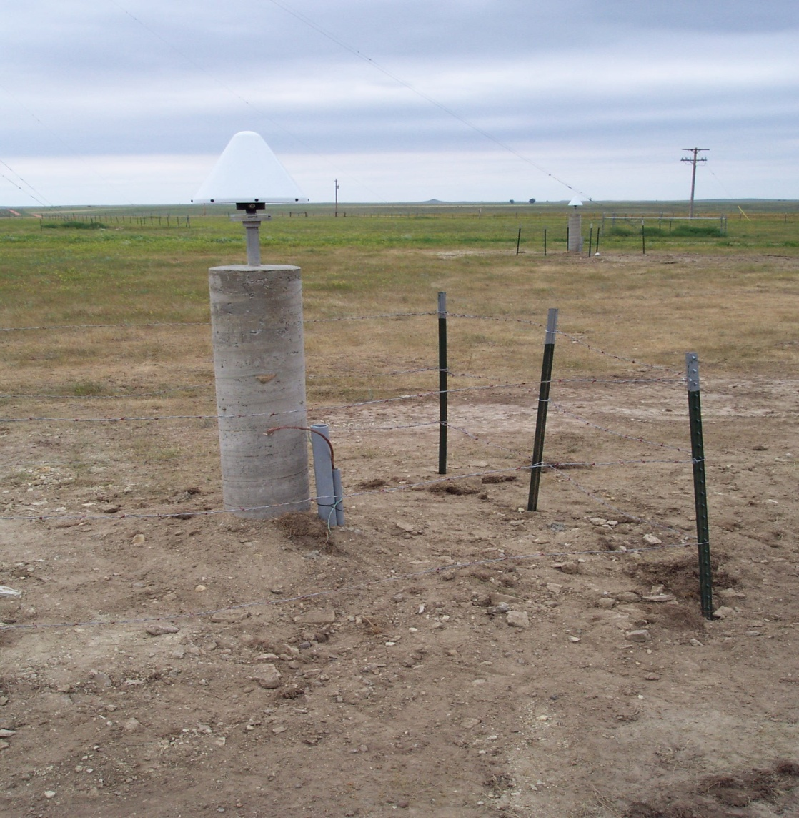
STATION MEDORA
(the geodetic antenna)

Slide 26
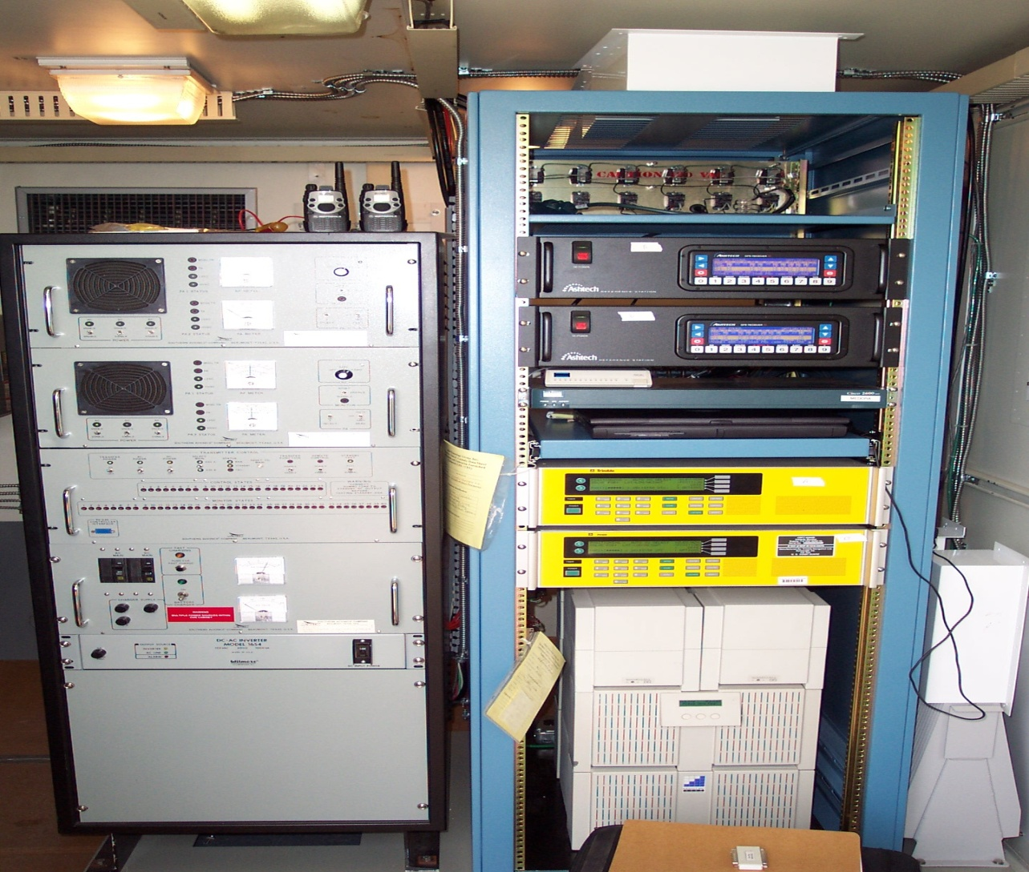
STATION MEDORA
(the GPS Receivers)

Slide 27
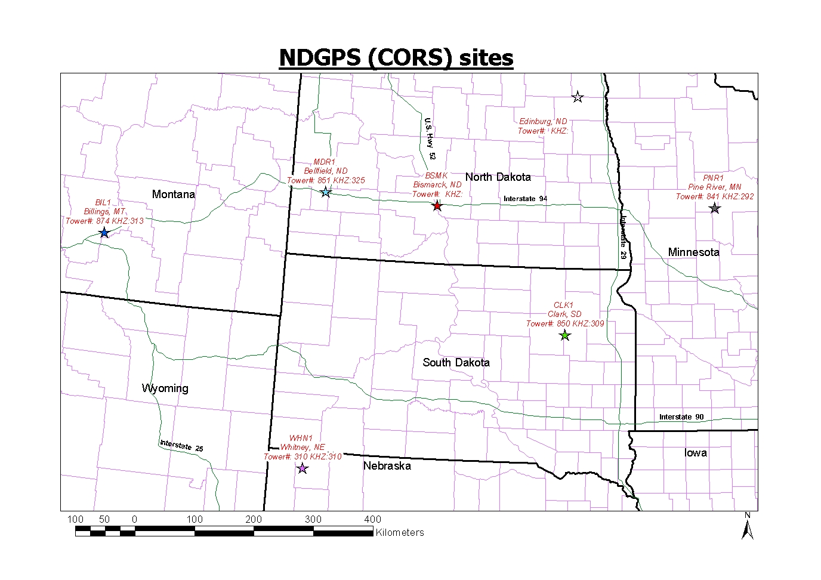
NDGPS SITES IN & NEAR ND

Slide 28
NDGPS & OPUS-RS

Slide 29
More Photos
Let’s follow them
Where are they going now?

Slide 30
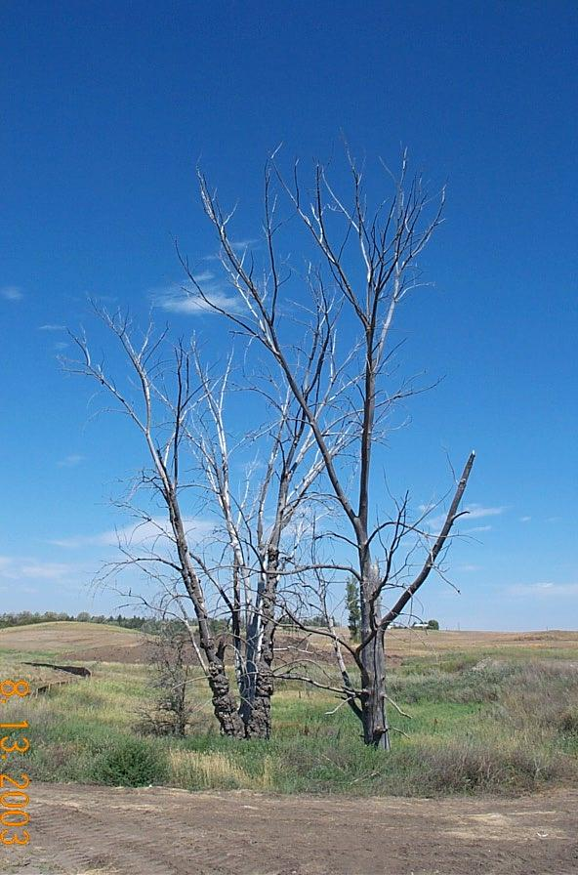

Dead Trees!

Slide 31

Not everything is dead

Slide 32
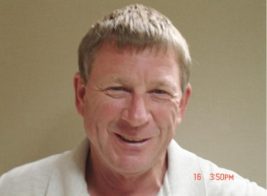
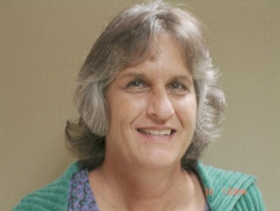
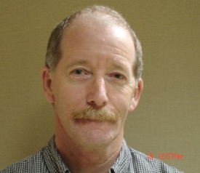
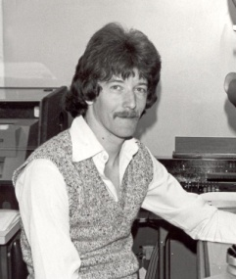
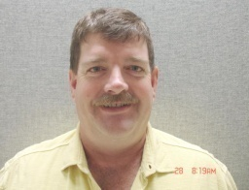

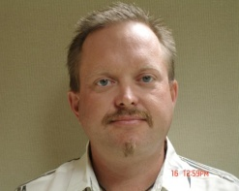
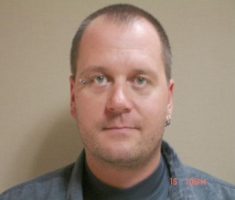
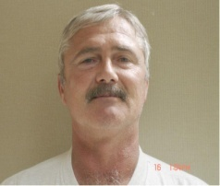
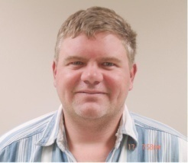
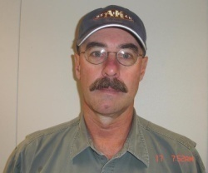
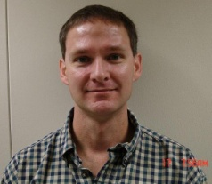
SPECIAL “THANK YOU” TO THE
SURVEYS & PHOTOGRAMMETRY STAFF
SURVEYS
RIGHT OF WAY PLATS
PHOTOGRAMMETRY
Greg Lattimore, LS
Lou Ann Adams, LS
Paul Stubbs
Guess who?
Robert Zahn, LS
Adam Cahlin
Chad Hanson, LS
Troy Zornjak
Eric Atwood
Mike Lang
Will Patrick
Monte Obrigewitch

Slide 33
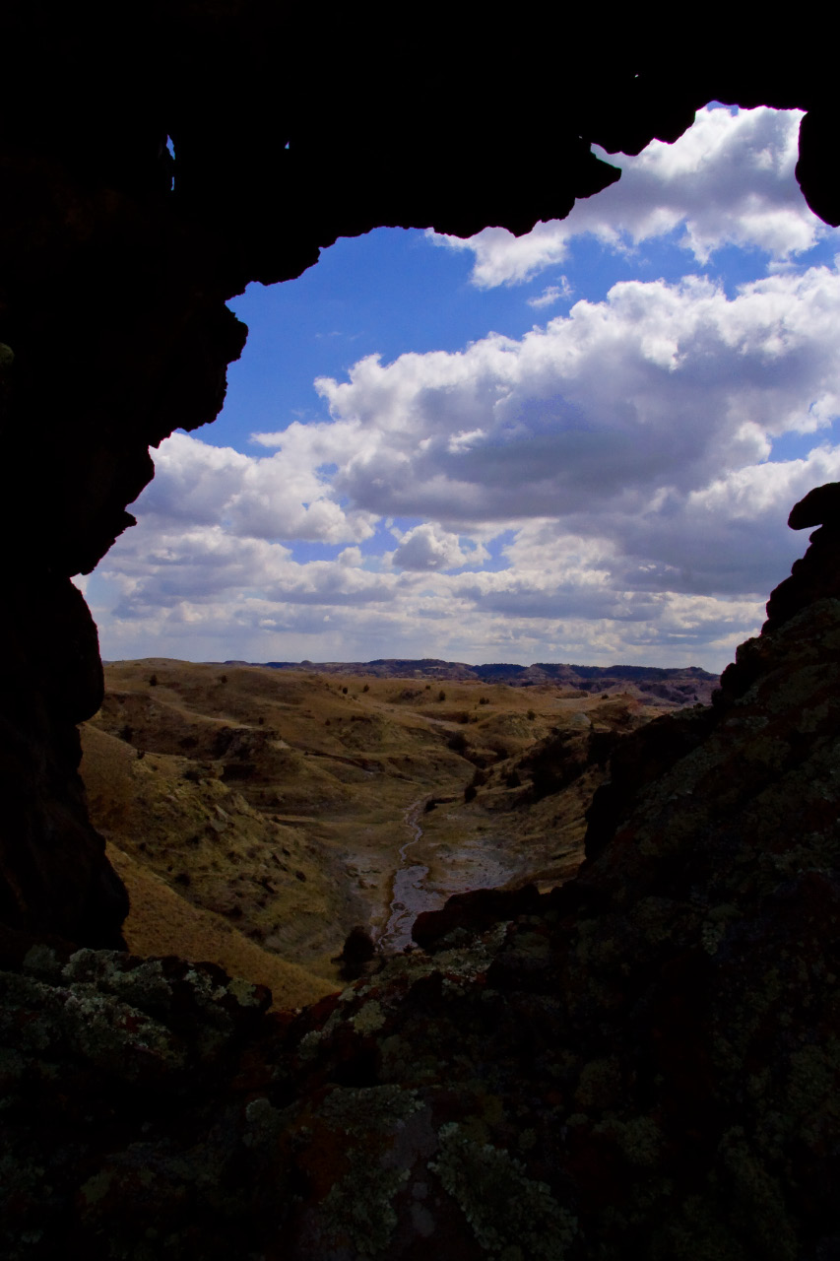
PLAY STANLEY NEXT
THE END

